Slide 1
Hvar Observatory
Faculty of Geodesy
Kačićeva 26, 10 000 Zagreb

Slide 2
Double Solar Telescope at Hvar
Hvar Observatory - http://oh.geof.unizg.hr

Slide 3
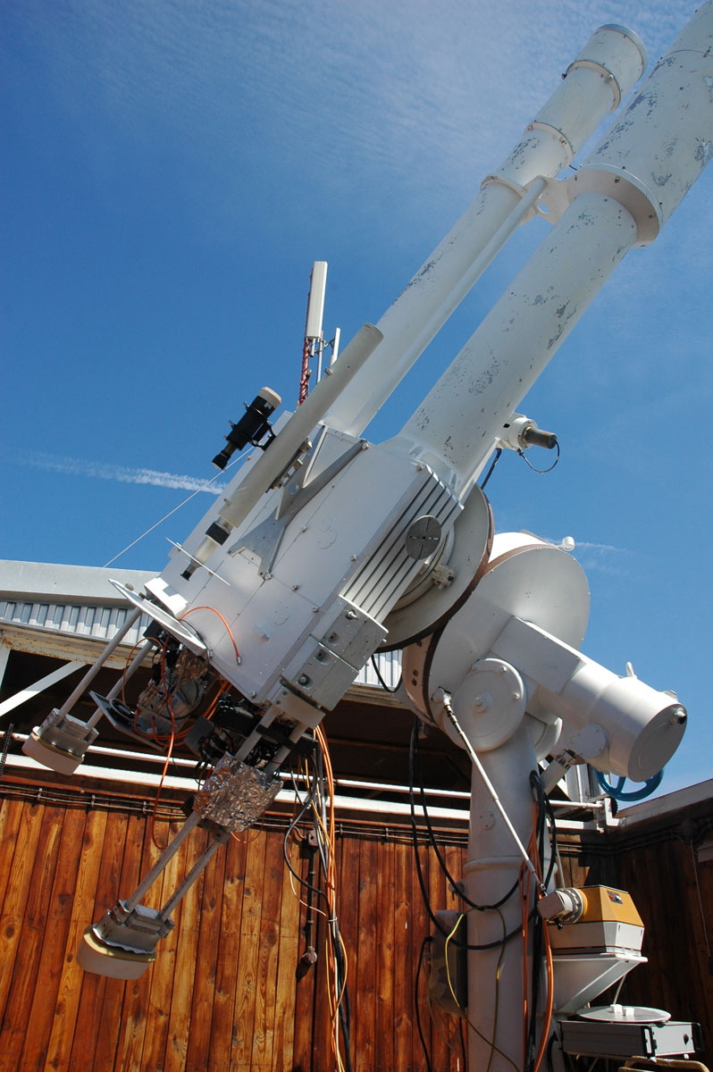
Double Solar Telescope at Hvar
Consists of two Carl Zeiss refractors (photospheric telescope d=217mm, chromospheric telescope d=130mm) mounted as one unit on a German parallax mounting
Aim to produce high resolution images of active regions on the Sun
Pullnix TM-4200GE 12-bit CCD cameras allow time series with a cadence up to 30 images per minute (valuable tool to study rapid changes of chromospheric and photospheric features)
Hvar Observatory - http://oh.geof.unizg.hr

Slide 4
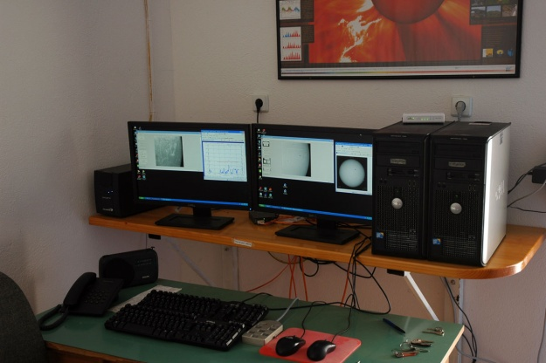
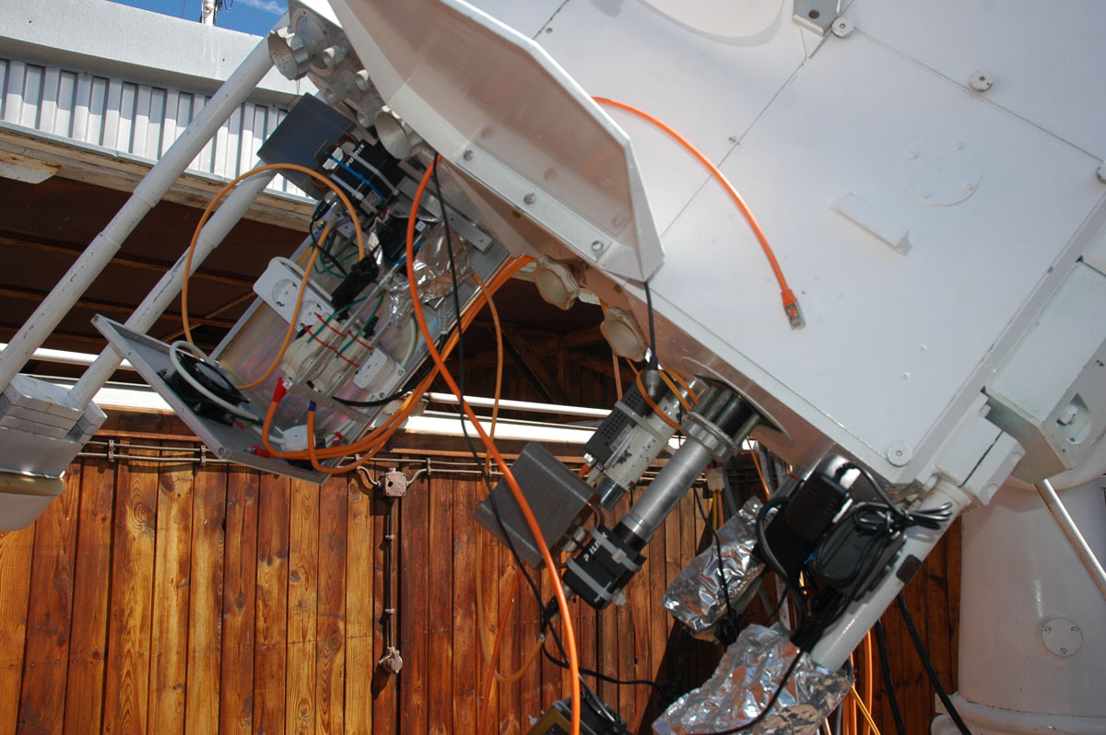
Double Solar Telescope at Hvar
Telescope control room
New acquisition system
Hvar Observatory - http://oh.geof.unizg.hr

Slide 5
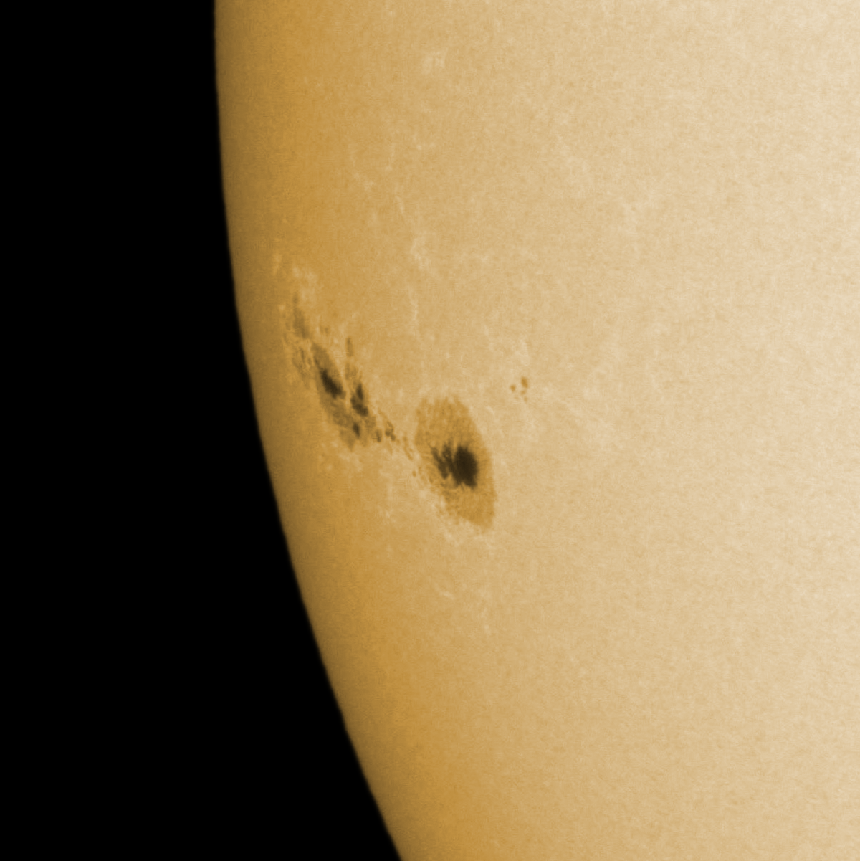
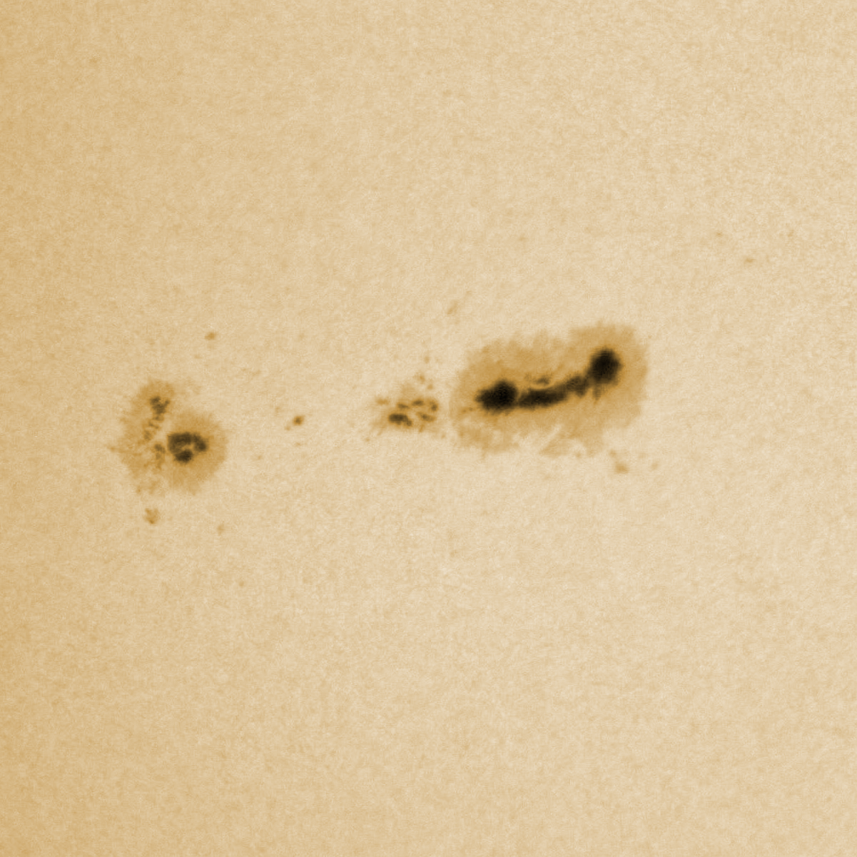
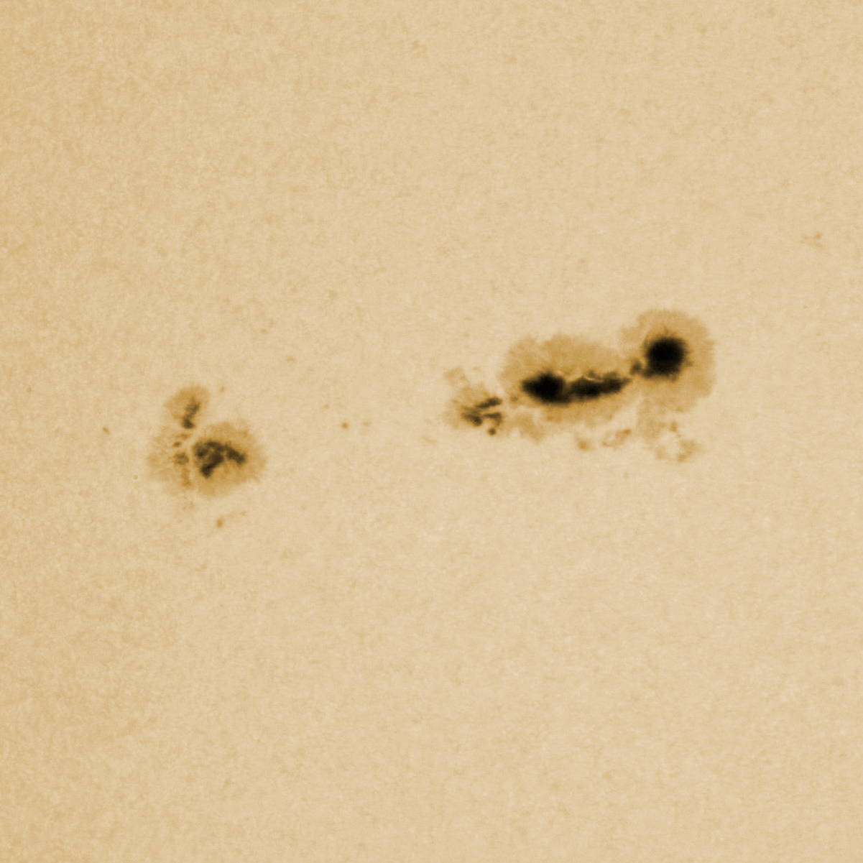
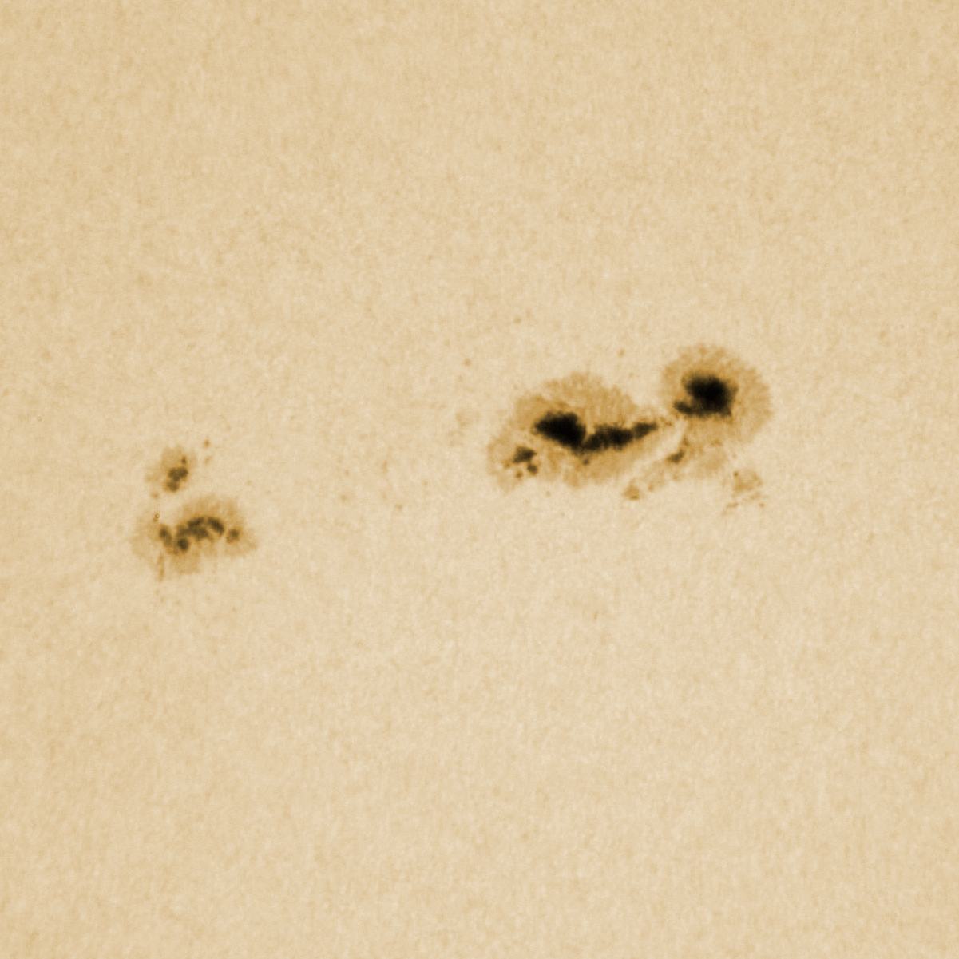
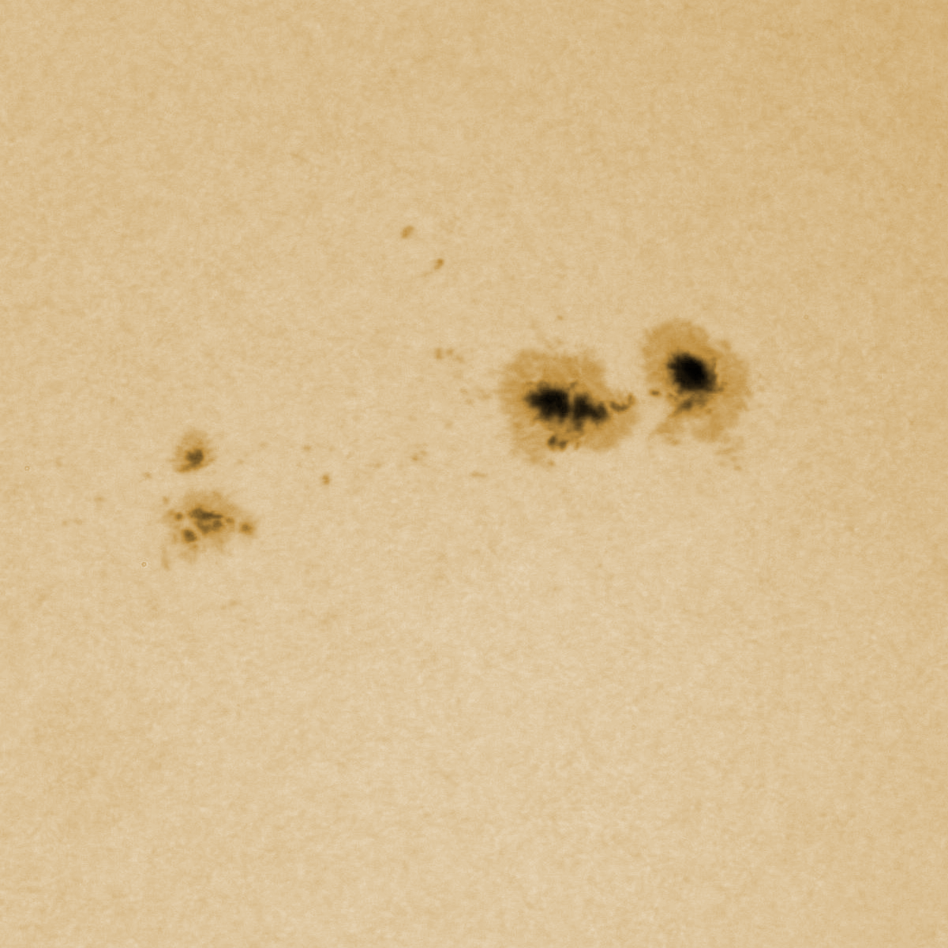
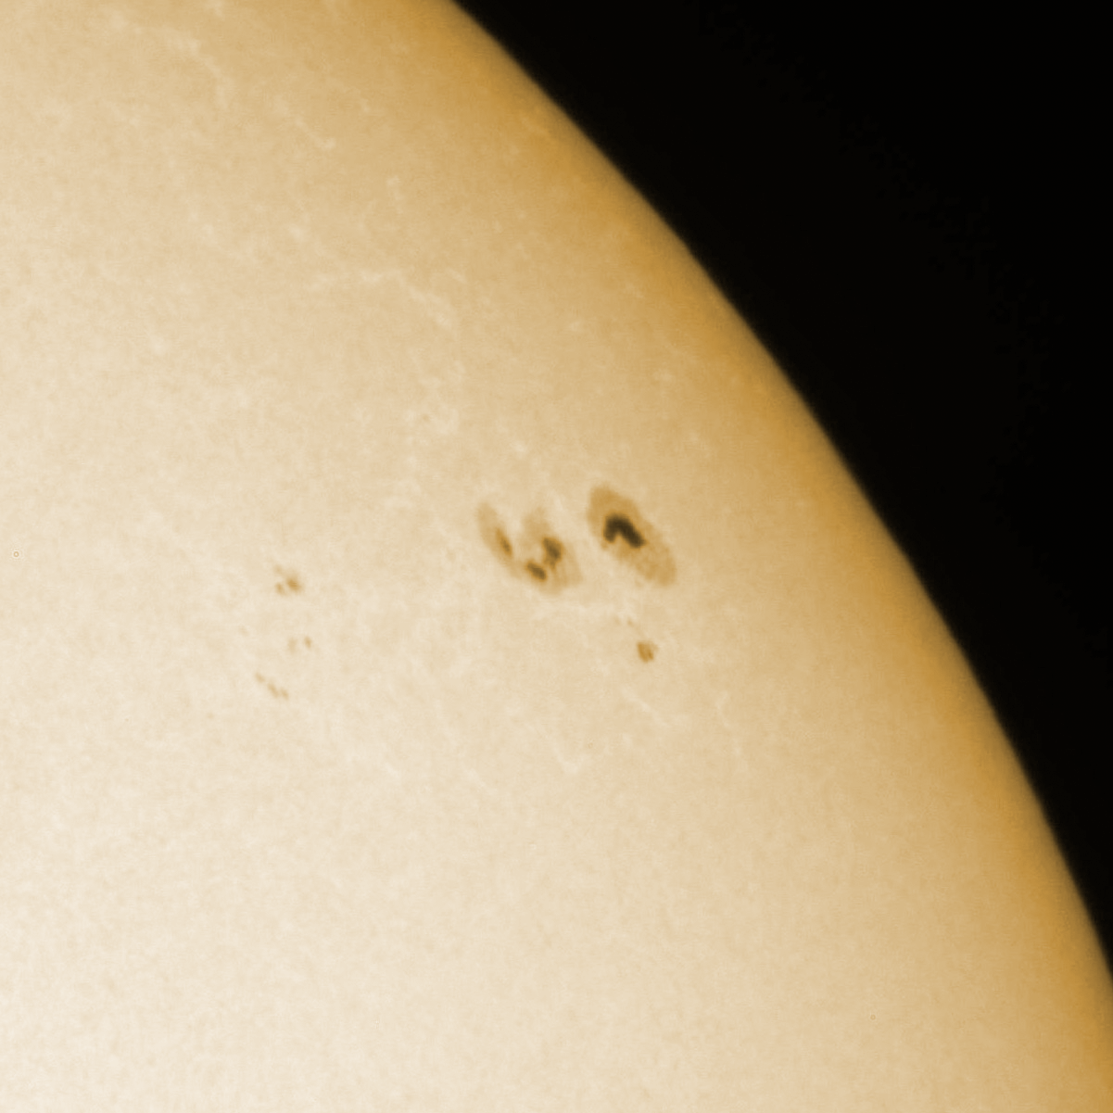
Hvar Solar Telescope
23.9.2011 08:52 UT
Photospheric observations (white light)
Hvar Observatory - http://oh.geof.unizg.hr
27.9.2011 11:40 UT
28.9.2011 08:03 UT
Evolution of Sunspot group 11302
29.9.2011 06:44 UT
30.9.2011 10:19 UT
03.10.2011 07:39 UT
Notes:
8919 slika…

Slide 6
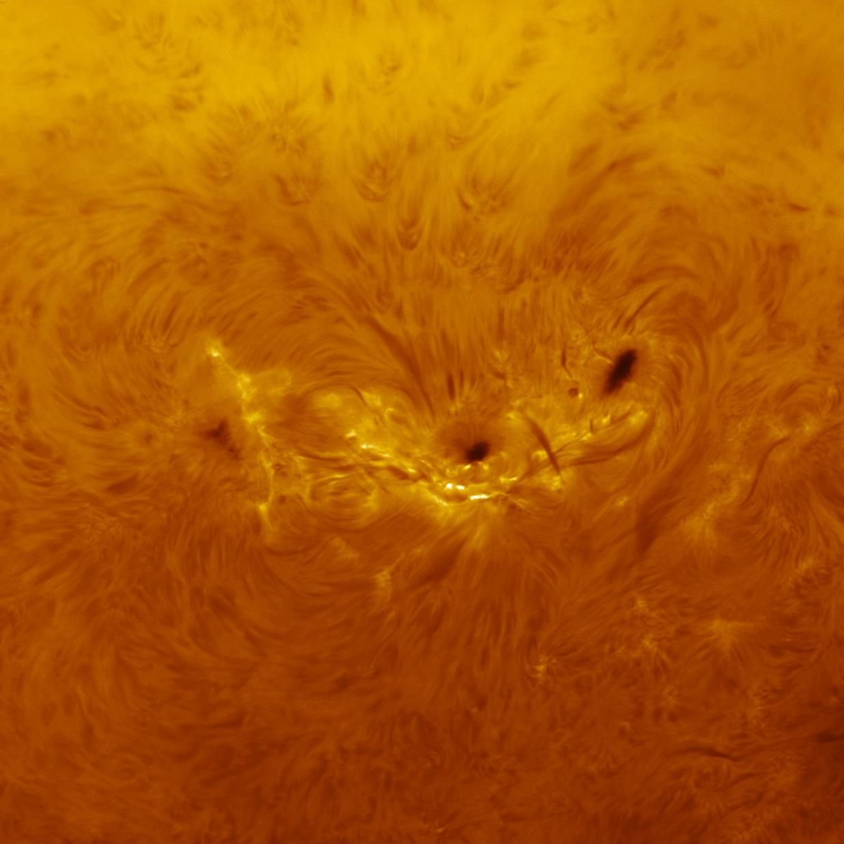
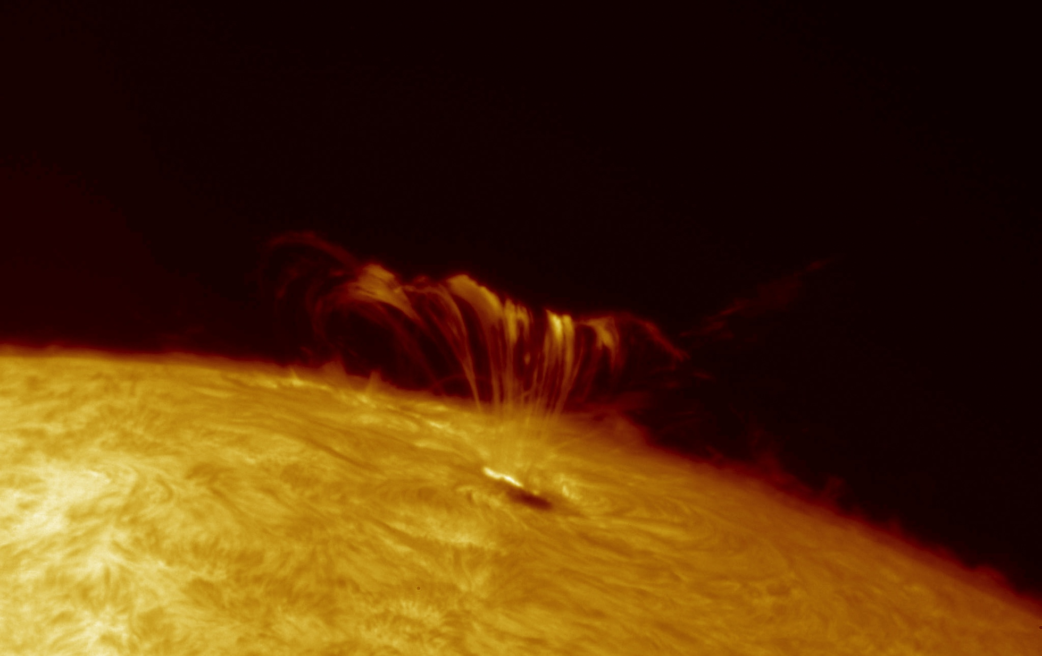
Hvar Solar Telescope
Chromospheric observations (Hα)
22.09.2011, Solar flare (X1.4), sunspot group 11302
Hvar Observatory - http://oh.geof.unizg.hr
04.07.2012, 11:55 UTC
Sunspot group: 1515
Notes:
8919 slika…

Slide 7
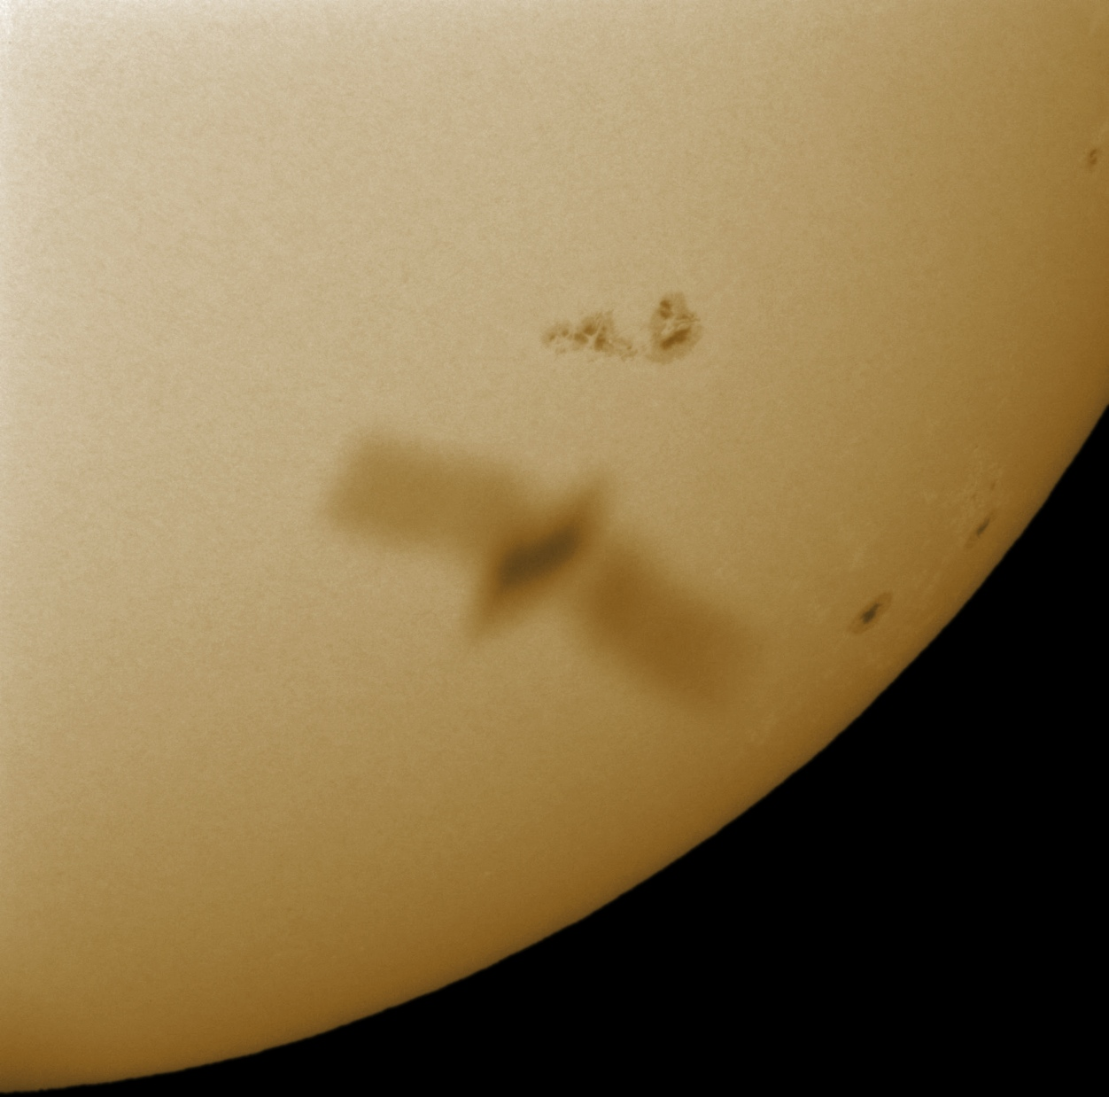
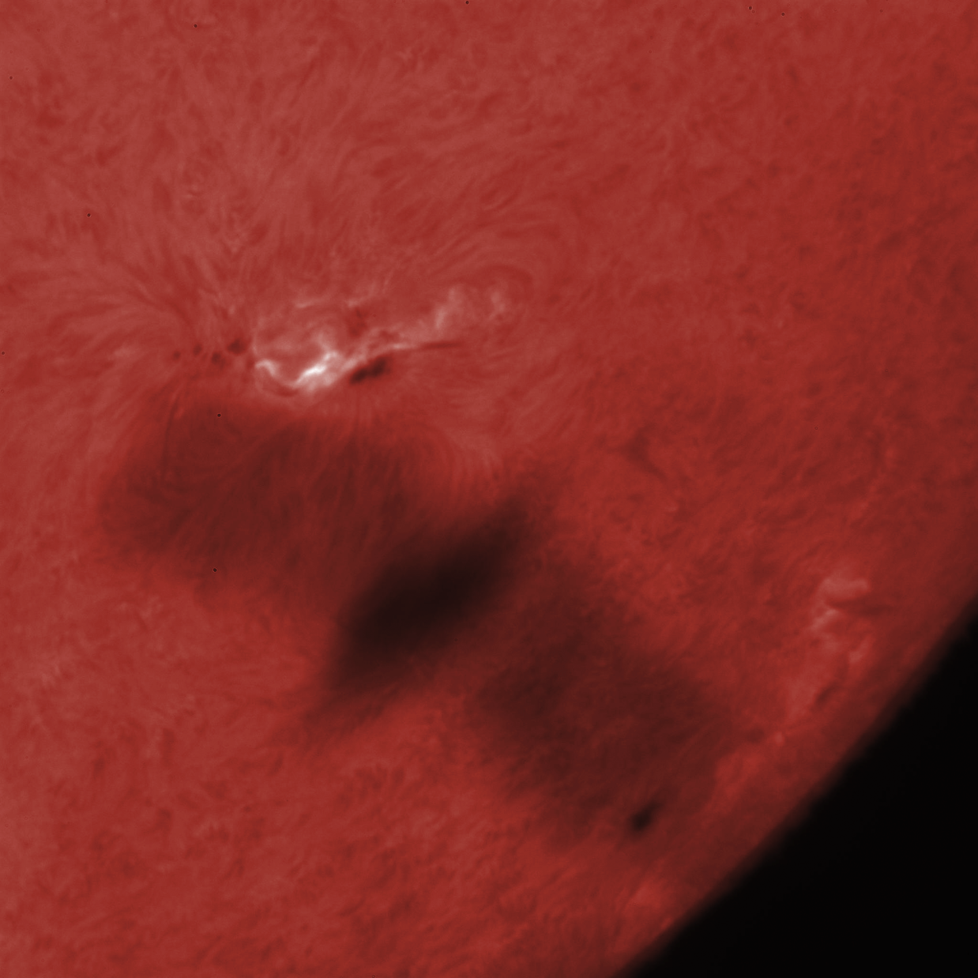
Hvar Solar Telescope
27.10.2013, 12:02 UTC
Photosphere
Chromosphere
Hvar Observatory - http://oh.geof.unizg.hr
Notes:
8919 slika…

Slide 8
Hvar Solar Telescope
Solar flare (M5), 02.07.2012
Chromospheric observations
Hvar Observatory - http://oh.geof.unizg.hr
Notes:
8919 slika…

Slide 9
Hvar Solar Telescope
Venus transit, 06.06.2012
Chromospheric observations
Hvar Observatory - http://oh.geof.unizg.hr
Notes:
8919 slika…

Slide 10
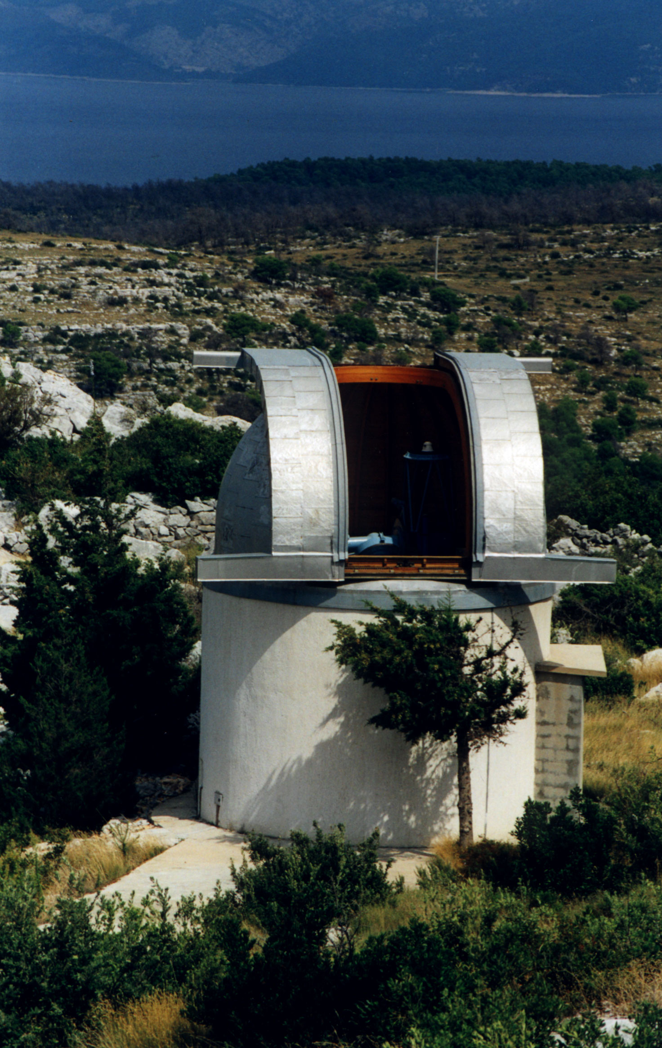
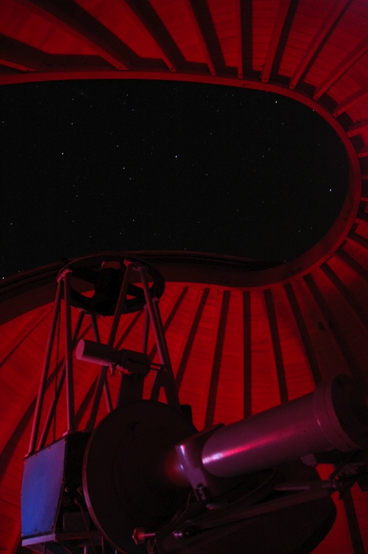
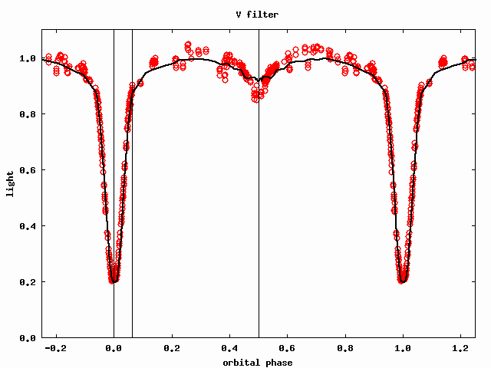
65-cm Stellar Telescope at Hvar
Photometric monitoring program of variable stars
Hvar Observatory - http://oh.geof.unizg.hr
Notes:
8919 slika…

Slide 11
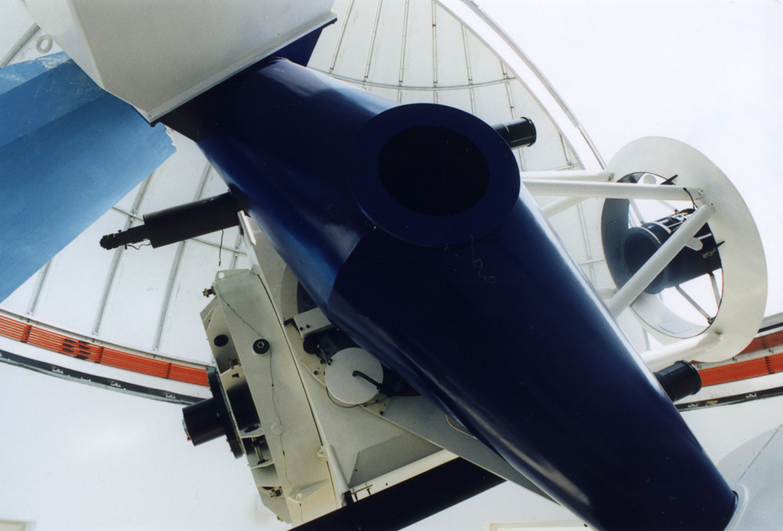
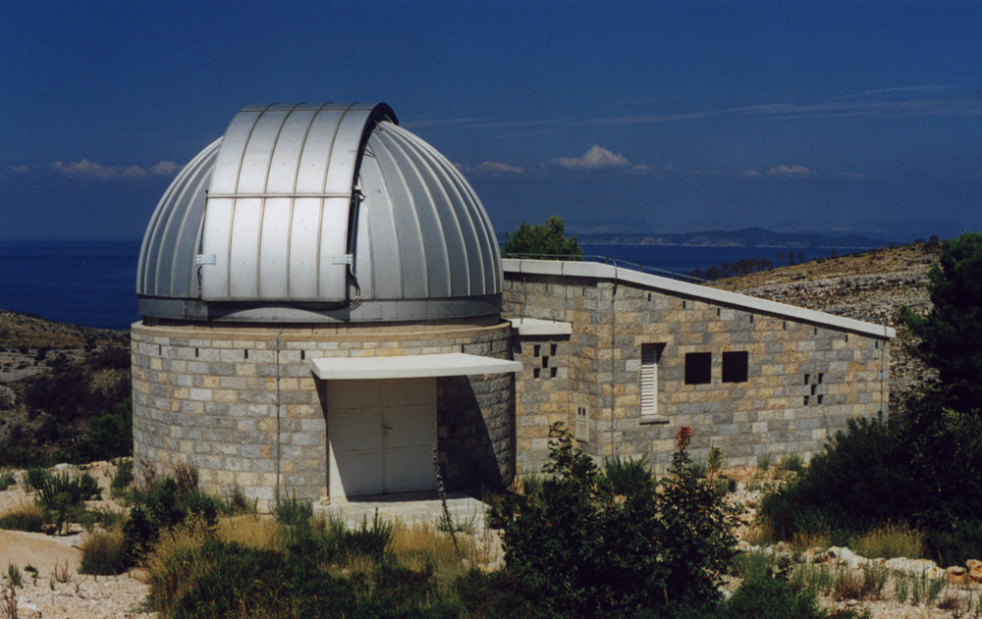
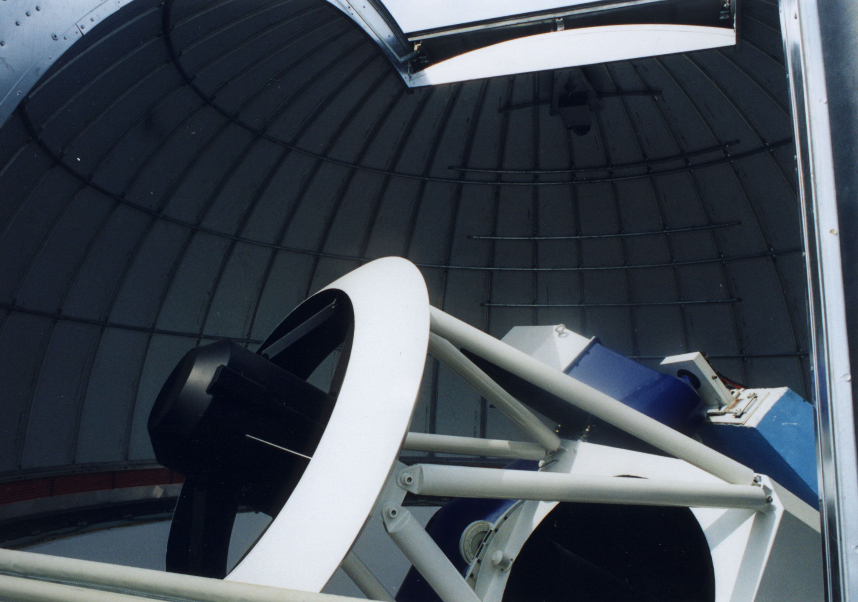
1-m Austro-Croatian Telescope (ACT)
Hvar Observatory - http://oh.geof.unizg.hr
Notes:
8919 slika…

Slide 12
Solar activity and its influence on the heliosphere and geospace (solar storms)
Hvar Observatory - http://oh.geof.unizg.hr
Notes:
8919 slika…

Slide 13
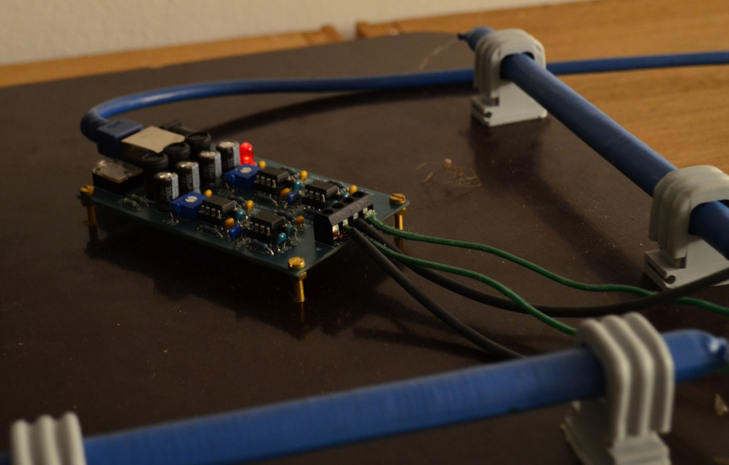
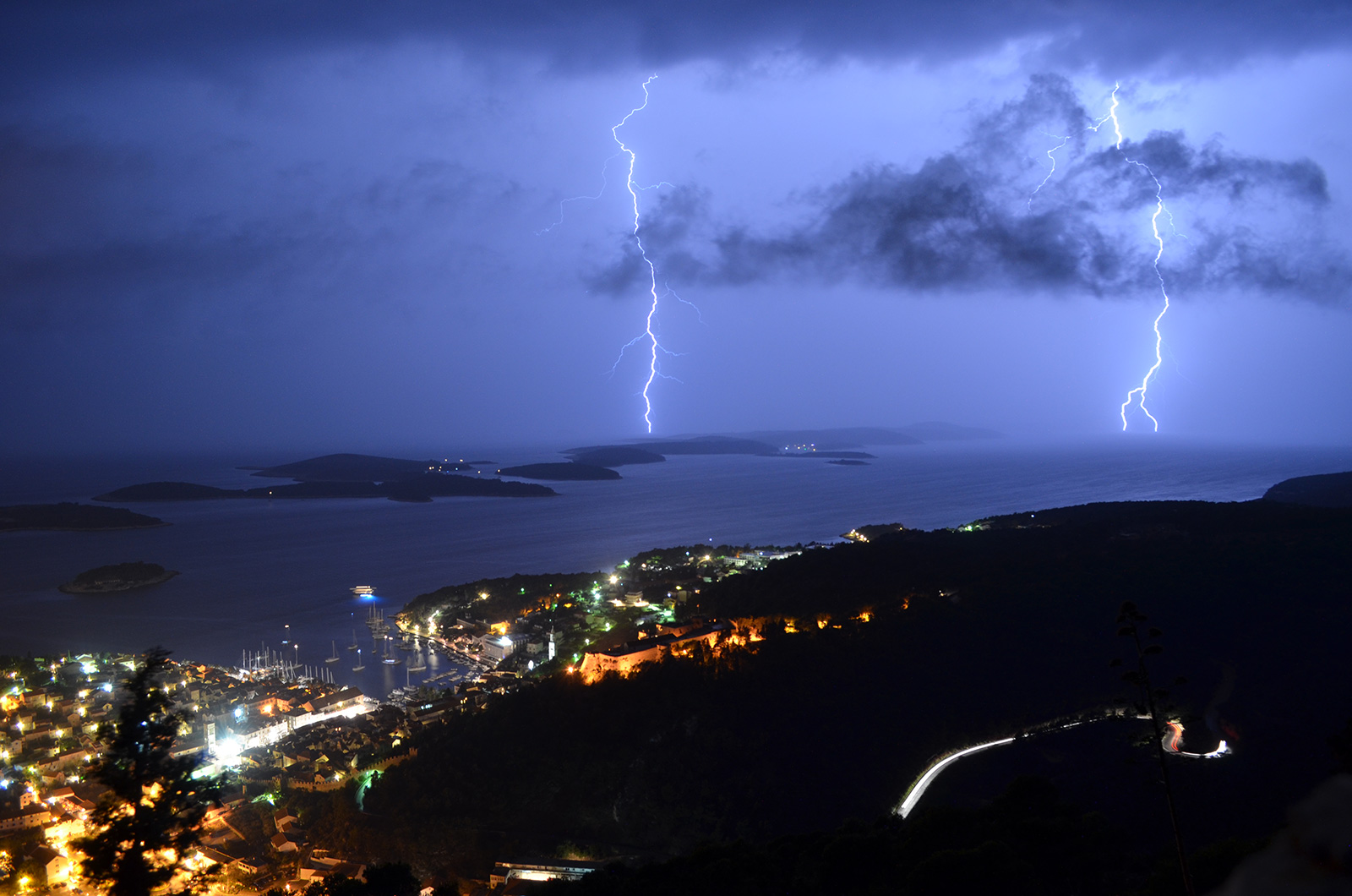
Influence of solar variability on Earth's climate
Lightning radar station Hvar
http://www.blitzortung.org
Hvar Observatory - http://oh.geof.unizg.hr
Notes:
8919 slika…

Slide 14
For more information about Hvar Observatory visit us:
http://oh.geof.unizg.hr

