Slide 1








Catalog of large amplitude oscillations (LAO catalog)
Europska Unija
Ulaganje u budućnost
Projekt je sufinancirala Europska Unija iz
Europskog socijalnog fonda
Mateja Dumbović & Jaša Čalogović
Hvar Observatory, Faculty of Geodesy,
University of Zagreb

Slide 2
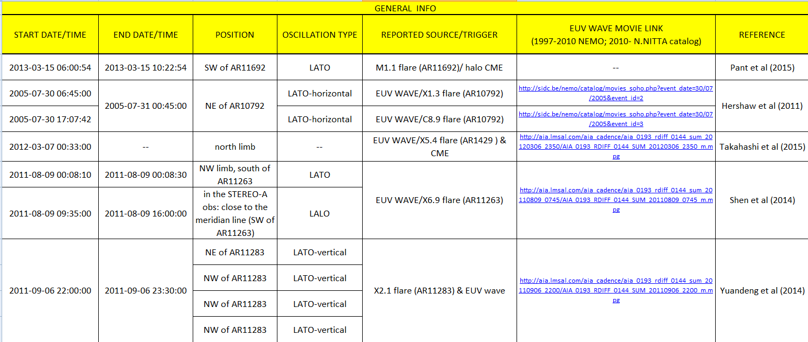
April 2010 – Today: SDO/AIA EUV waves catalog
March 1997 – February 2010: NEMO catalog
AIM: EVENT LIST
Should we add other information?

Slide 3
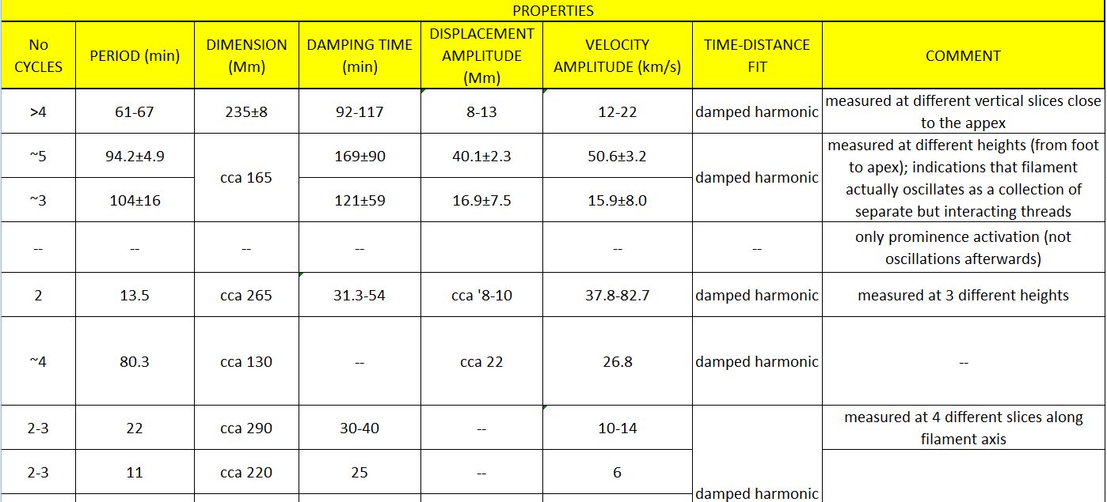
Some provide measurements at different heights or slices, some give average values…
What is the best approach? Average values?
What in case when period depends on time?

Slide 4
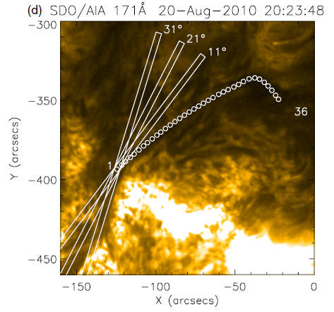
The projected length of the filament, determined roughly by approximating filament with the straight lines
Is that “good enough”?
from Luna et al (2014)

Slide 5
Other properties?
(e.g. phase?)
Calculate Alfven velocity?
Calculate damping time/period?
Other suggestions?

Slide 6
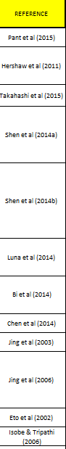
SO FAR….
12 papers
19 events
(not all have properties measurements)
9 LATO, 9 LALO
44% triggered by EUV wave
78% LATO’s triggered by EUV wave (11% LALO’s)
Damping time vs period
(damped harmonic only)
61% triggered by flare
89% LATO’s triggered by flare (33% LALO’s)

Slide 7
SO FAR….
12 papers
19 events
(not all have properties measurements)
9 LATO, 9 LALO
44% triggered by EUV wave
78% LATO’s triggered by EUV wave (11% LALO’s)
Period vs “length”
(all damped harmonic events)
61% triggered by flare
89% LATO’s triggered by flare (33% LALO’s)

Slide 8
Period vs “length”
all damped harmonic events
LATO’s
What to make of this?

Slide 9
What would be useful regarding the statistical analysis?

