Slide 1
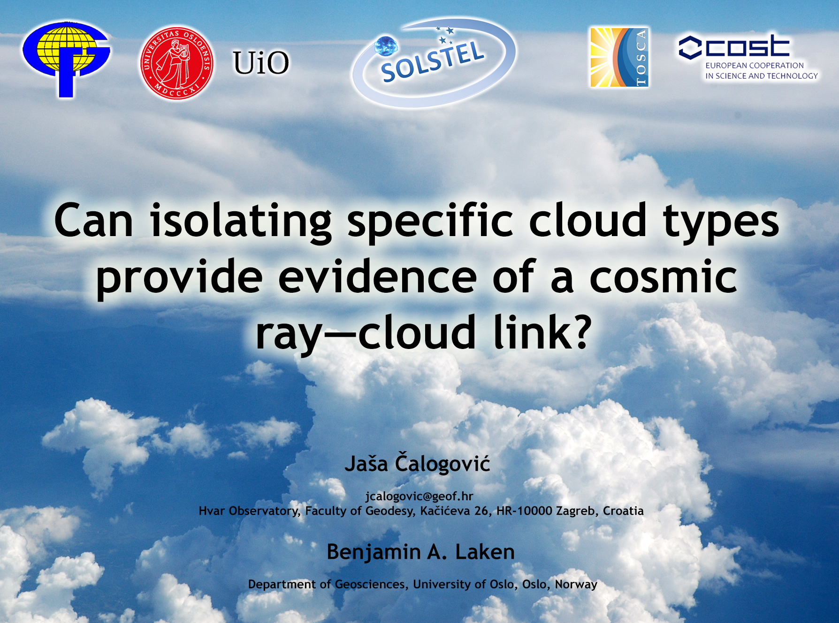
Notes:
Emphasis on the observations to test the GCR-cloud hypothesis – satellite data
Thanks to Ben…

Slide 2
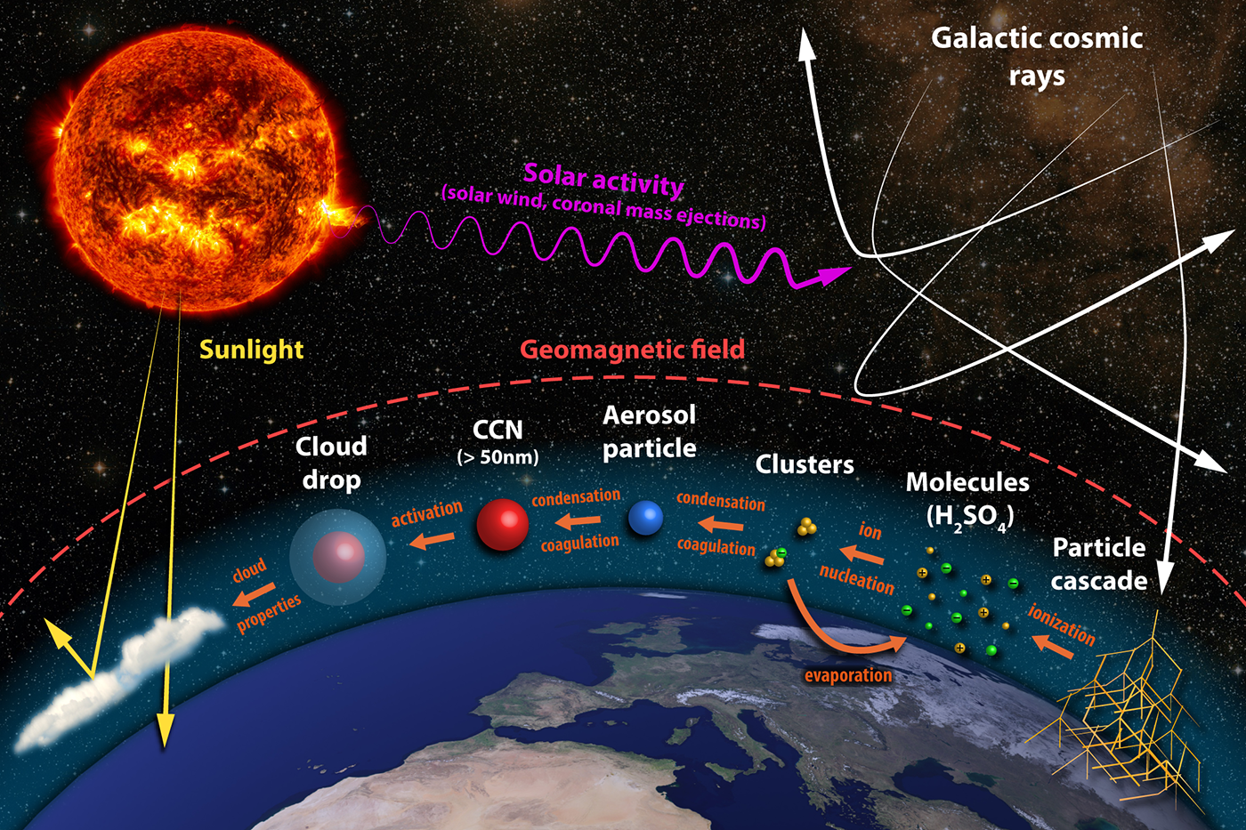
Laken & Čalogović, TOSCA handbook

Slide 3
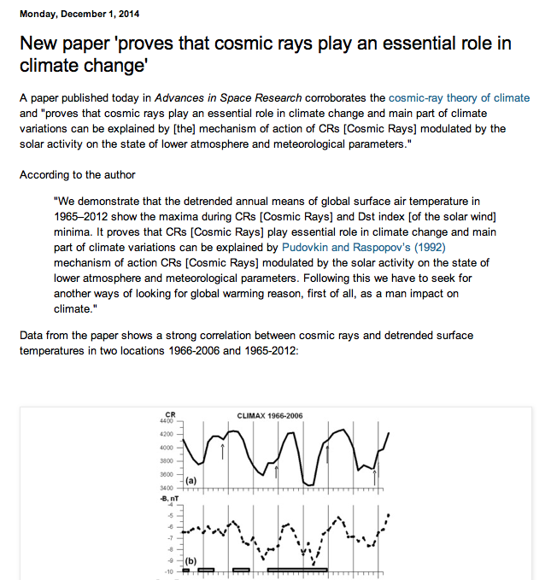
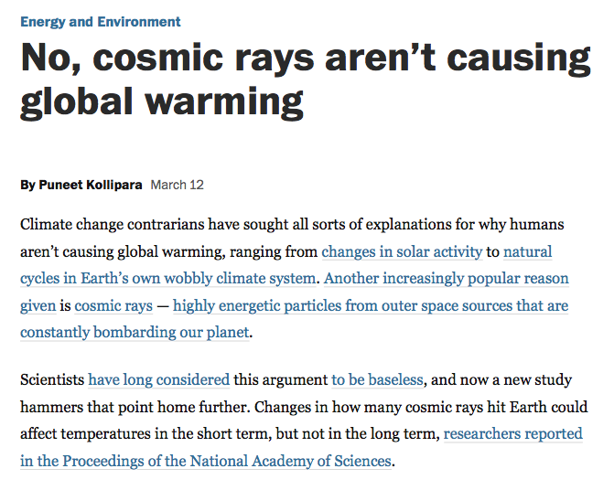
Still controversial topic…
… and beloved argument for climate skeptics!

Slide 4
Scientific papers show also conflicting results
(eg. Short-term studies using Forbush decreases)
  positive correlations:
  Tinsley & Deen, 1991; Pudovkin & Vertenenko, 1995; Todd & Kniveton, 2001; 2004; Kniveton, 2004; Harrison & Stephenson, 2006; Svensmark et al., 2009; Solovyev & Kozlov, 2009; Harrison & Ambaum, 2010; Harrison et al. 2011; Okike & Collier, 2011; Dragić et al. 2011; 2013; Svensmark et al., 2012; Zhou et al. 2013, Veretenko & Ogurtsov 2015, Tsonis et al. 2015
  negative correlations:
  Wang et al., 2006; Troshichev et al., 2008
  no correlations or inconclusive results:
  Pallé & Butler, 2001; Lam & Rodger, 2002 ; Kristjánsson et al., 2008 ; Sloan & Wolfendale, 2008; Laken et al., 2009; Čalogović et al., 2010; Laken & Kniveton 2011; Laken et al., 2012
Why?
Improper use of statistical tools / wrong statistical assumptions
“quality” and properties of cloud datasets

Slide 5
Open-access coding solution
Reliable methods/tests to overcome some noted difficulties: communal analysis approach
Implementation of robust significance testing (e.g. MC method)
Python (free+open, all platforms, easy to learn/use)
IPython: code in small editable units, code, figures, and descriptions mixed. Rapidly shared and replicated.
Public Git repositories for communal development: a ‘living’ version with a history
Allows even low-skilled programmers to follow the analysis. Viewed online, any system (only internet browser needed)
Using FigShare code/figures have their own DOI

Slide 6
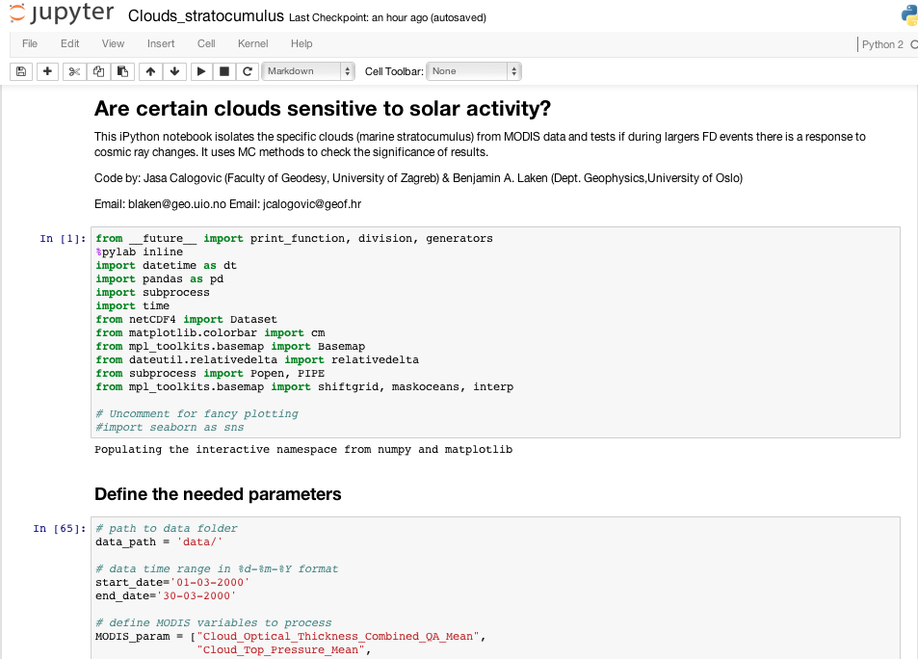
IPython environment

Slide 7
Identification of solar—terrestrial links has many issues
Large uncertainties still remain
Exact amplifying mechanisms linking solar activity to climate still poorly understood -> not always possible to even evaluate them
Cross-correlation of solar signals complicate attribution
Most studies purely statistical -> tests of significance may be accompanied by ambiguities (data selection, treatment, methods and assumptions). Vulnerable to autocorrelations, smoothing, human bias and post-hoc hypotheses.
Such difficulties in relation to solar—terrestrial field described already by Pittock 1979, 1978

Slide 8
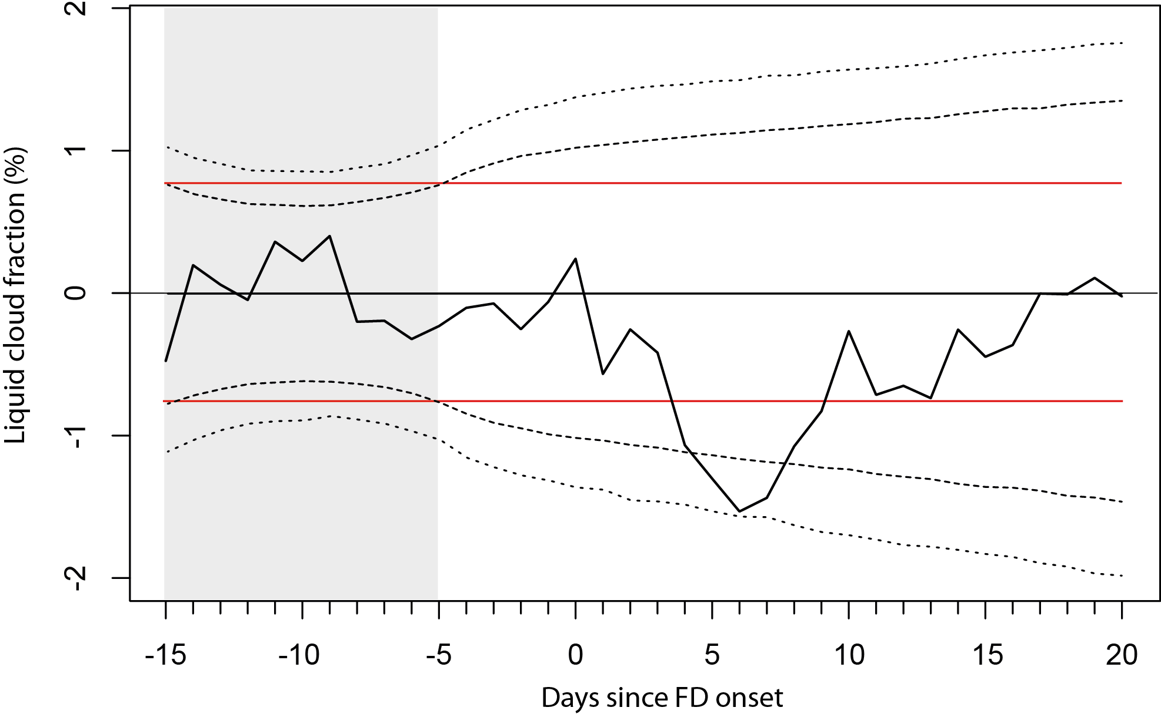
Big variability (noise) can be mixed with a hypothesised signal
Weather/climate is highly variable (i.e. noise) -> only small fraction can reasonably be linked to solar activity (i.e. signal)
Climate data have strong spatio-temporal auto-correlation
-> complicates statistical tests
Robust statictics (MC) show overly simplistic tests commonly applied (e.g. T-test) don't reliably assess significance
Example with clouds:
95 percentile(2σ)
Dashed/dotted lines show correctly adjusted 2 and 3σ confidence intervals (CI) – calculated from 10,000 MC simulations, red line shows CI (2σ) calculated based on normalization period assuming that data aren’t temporally auto-correlated.
99 percentile (3σ)

Slide 9
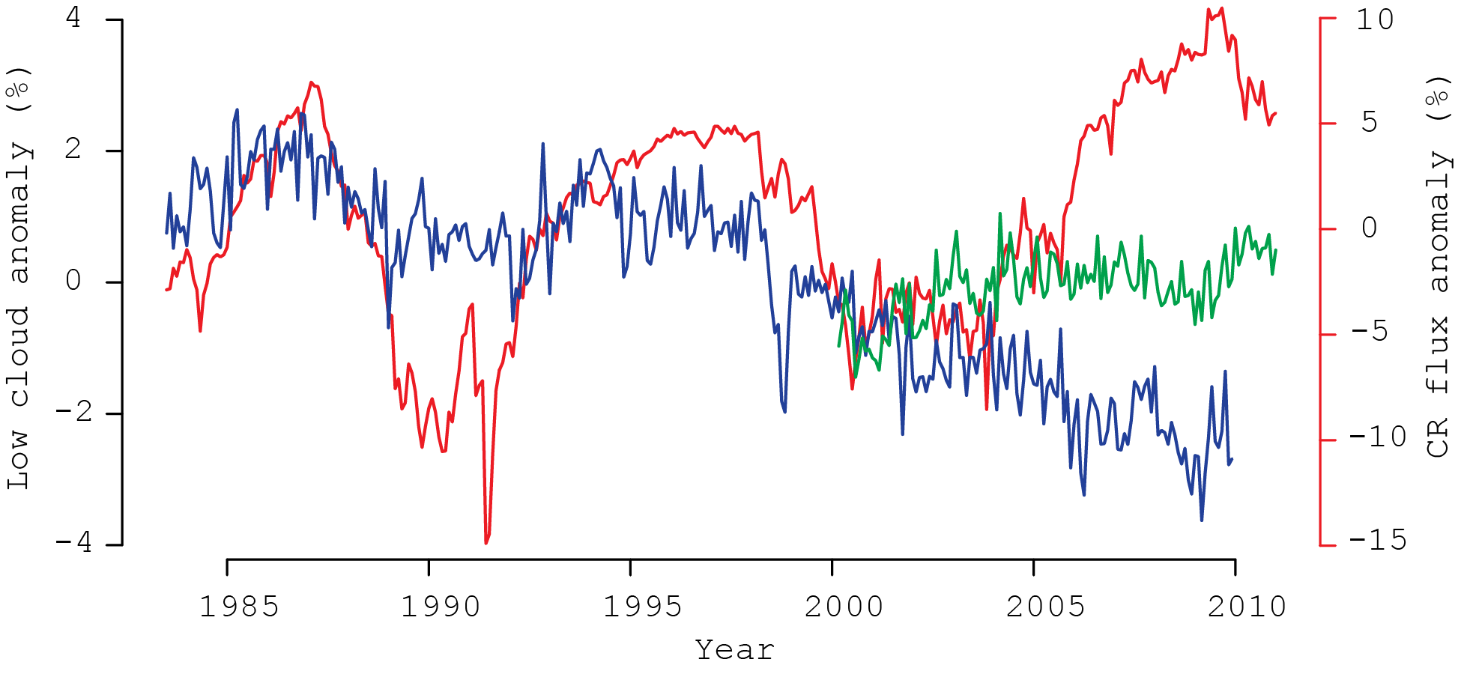
No link in long-term global cloud data
Correlations appear significant only over short-timescales (low clouds, 1983–1995)
Long-term satellite cloud data susceptible to errors/artificial trends, eg. low clouds obscured by overlying clouds, changes in satellite constellations, misindentification of cirrus clouds…
Other climate forcings may influence clouds too (eg. ENSO, volcanic eruptions...)
Low clouds (<3.2km), global
GCR flux
ISCCP low cloud anomaly (%)
Notes:
Climate proxies / cosmogenic isotopes – 10Be, 14C

Slide 10
Short-term studies also have limitations
Meteorological variability (noise) in clouds has to be reduced in order to detect the solar-related changes (signal)
Limited number of high-magnitude Forbush decrease events
Noise levels of data govern detectability of a signal. The noise varies with both the spatial area (a) considered by the data, and the number of composite events (n).
‘Noise’ indicated by 97.5th percentile values from 10,000 random composites of varying a and n size.
Each point of grid represents another independent set of 10,000 MC simulations

Slide 11

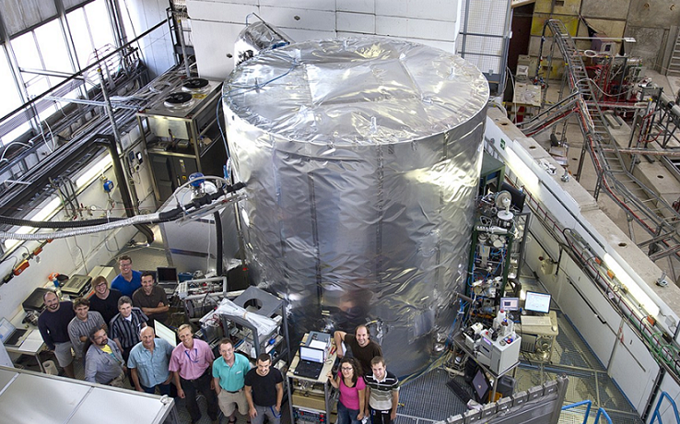
Laboratory and model experiments indicate small influence of ions on aerosols/clouds
Cosmics Leaving OUtdoor Droplets
Laboratory experiment with a cloud chamber to study the possible link between GCR and aerosol formation
Results show small contribution of ion-induced aerosol formation
Natural trace gases (acid-amine nucleation) tend to be much more effective in nucleation
(Almeida et al., 2013, Nature)
Model experiments also show small impact on the global cloud cover (Pierce & Adams, 2009; Dunne et al. 20102)

Slide 12
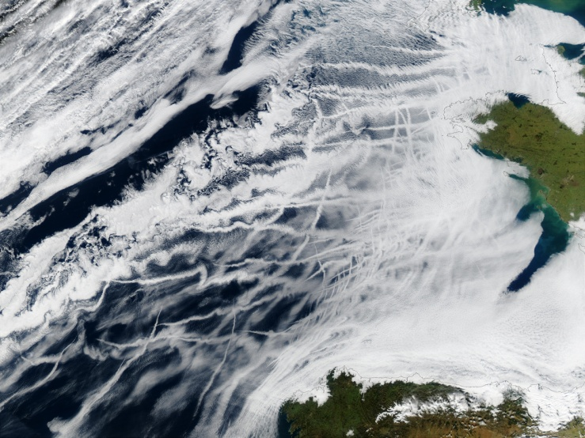
What about localized cloud effects?
E.g. Marine stratocumulus clouds (MSc)
There are locations where aerosols are in short supply and limit cloud formation
Small changes in the CCN concentration from combustion in such locations have been shown to dramatically alter clouds (e.g. Rosenfeld et al., 2006; Koren et al., 2012).

Slide 13
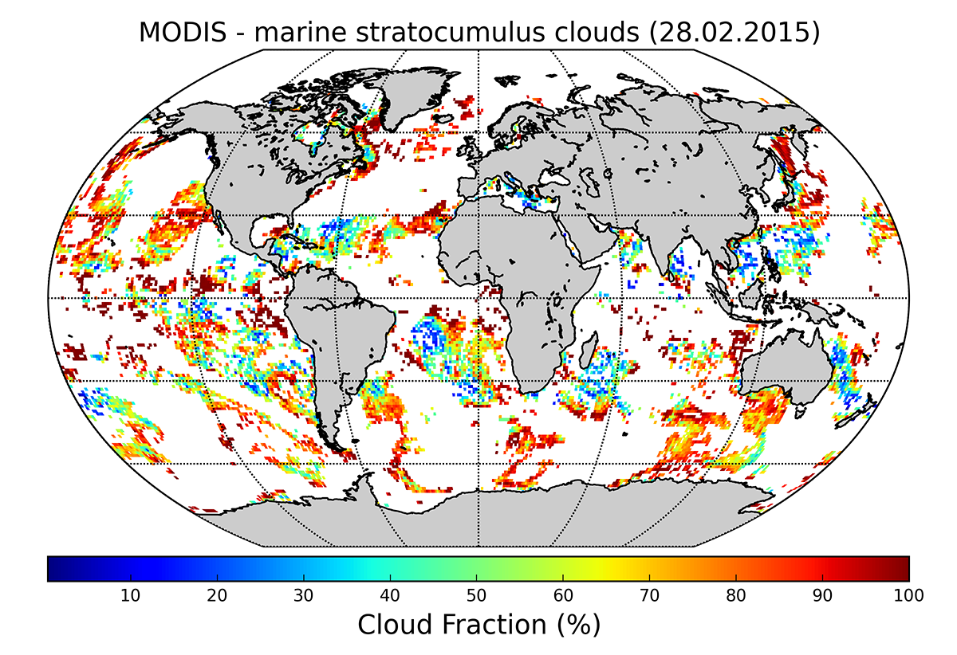
Analysis with IPython
MODIS Terra & Aqua Daily Level-3 data, ver. 5.1 (MOD08.D3.051)
Mask data by: (1) cloud-top pressure of >800 mb, (2) optical depth of 3.6 to 23.0, and (3) ocean-areas
16 strongest Forbush decreases
Advantages of analysis in IPython:
Can be applied to any dates rapidly
Easy selection of different cloud data (masks)
Implementation of robust statistical methods
Fast and scalable data processing

Slide 14
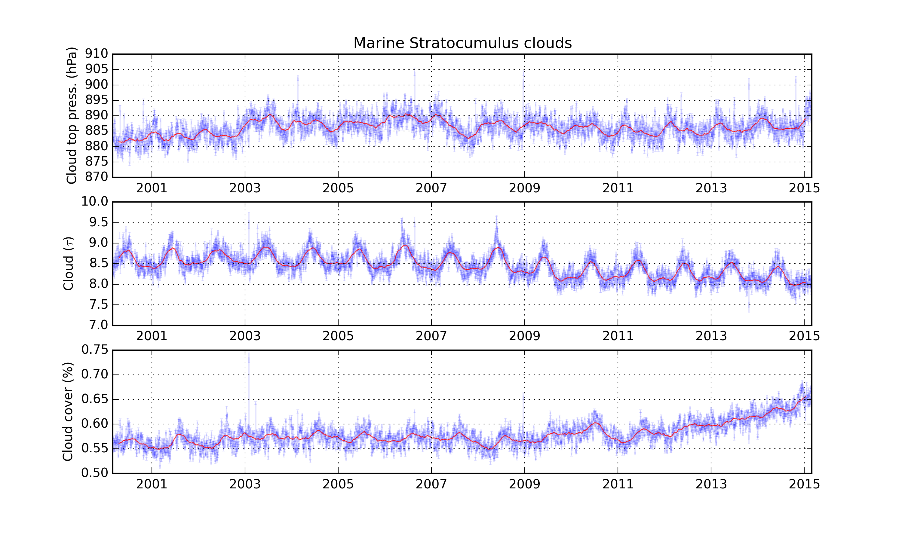
Cloud top pressure, optical depth and cloud cover for marine stratocumulus

Slide 15
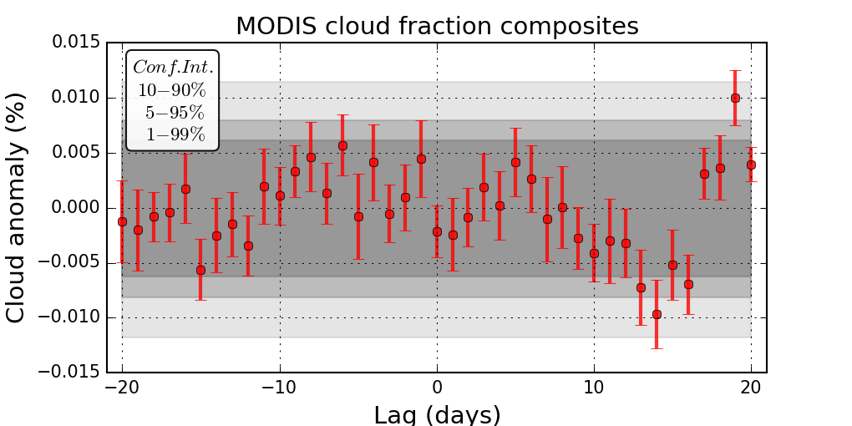
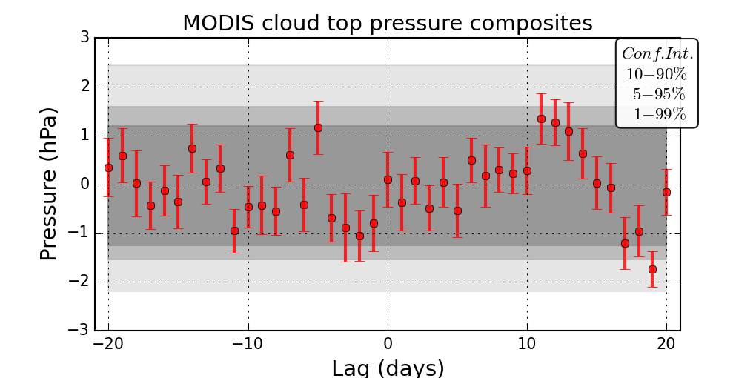
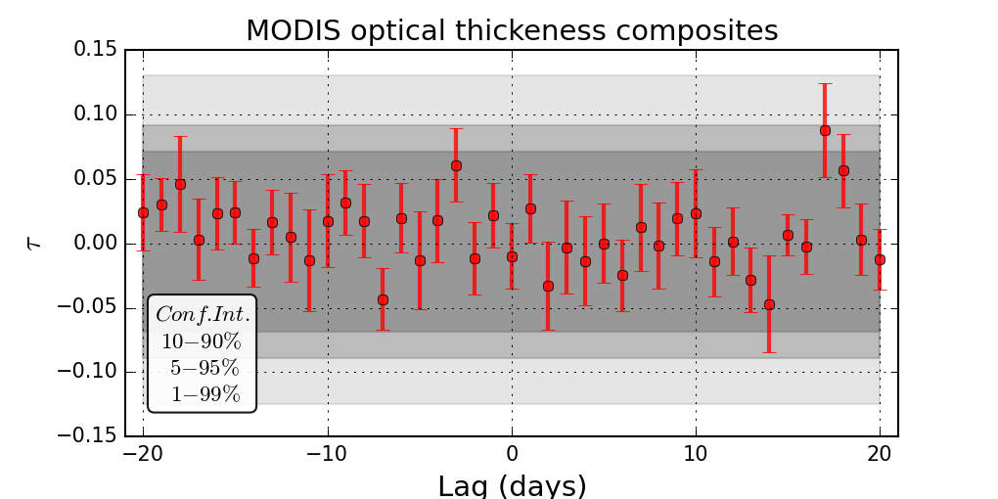
First results

Slide 16
Conclusions
GCR-cloud signal still undetected using global cloud satellite data
Diverse range of subtle, local-scale, impacts on clouds may still remain (e.g. high-level supercooled clouds)
Identification of solar—terrestrial links connected to many issues -> much uncertainty still pervades
Open access coding approach (IPython) allows us to better share experience/knowledge and solve some of the difficulties of past studies (reproducible work)

Slide 17

Thank you!
This work received support from European COST Action ES1005 (TOSCA) and SOLSTEL (HRZZ project 6212).
VIDEO BY: J. ČALOGOVIĆ, HVAR, SEPTEMBER 2013

Slide 18
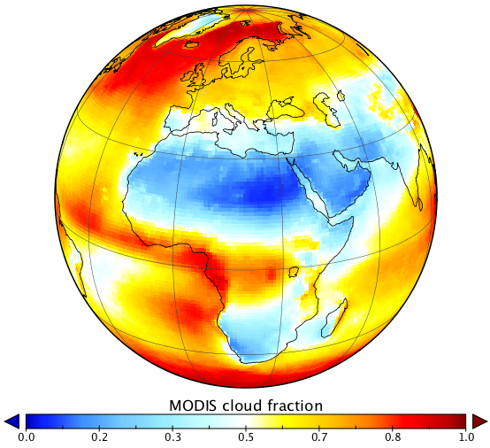
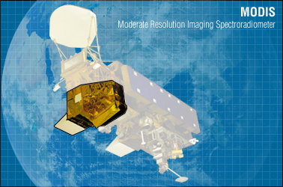
MODIS cloud data
MODerate Resolution Imaging Spectroradiometer
  views in 36 channels from Visible to thermal IR, on board two polar orbiting satellites Aqua, and Terra, operational since 2000
  temporal resolution: 12h, spatial resolution: 1° x 1°
  MODIS Terra & Aqua Daily Level-3 data, ver. 5.1 (MOD08.D3.051), available since 01.03.2000 till today
Notes:
Surface measurements of clouds and sunshine - available only in limited regions, limited quality (e.g. Udelhofen & Cess, 2001, GRL)

Slide 19
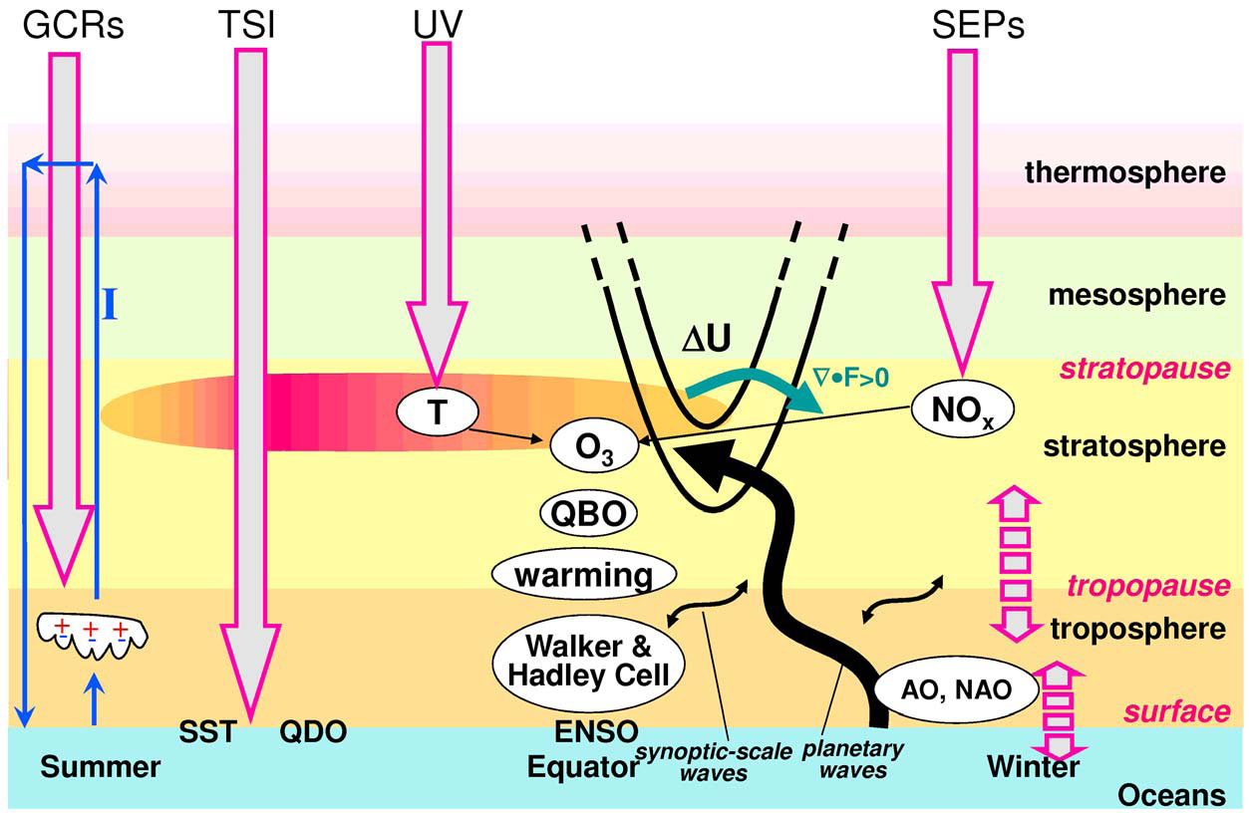
Theoretical solar influence on climate
Kodera & Kuroda , 2002

