Slide 2
History of Hvar double solar telescope
Installed in 1972 based on an agreement between Faculty of Geodesy of the University of Zagreb and the Astronomical Institute of the Czechoslovak Academy of Sciences, Ondrejov.
In establishment of Hvar Observatory from Czechoslovak side were participating (Astronomical Institute, Ondrejov):
Dr. B. Valníček, Dr. V. Bumba, Doc. L. Perek, Ing. V. Rajský, Prof. F. Šorm
And from Yugoslav side (Faculty of Geodesy):
Prof. Veljko Petković and later Dr.sc. Vladimir Ruždjak

Slide 3
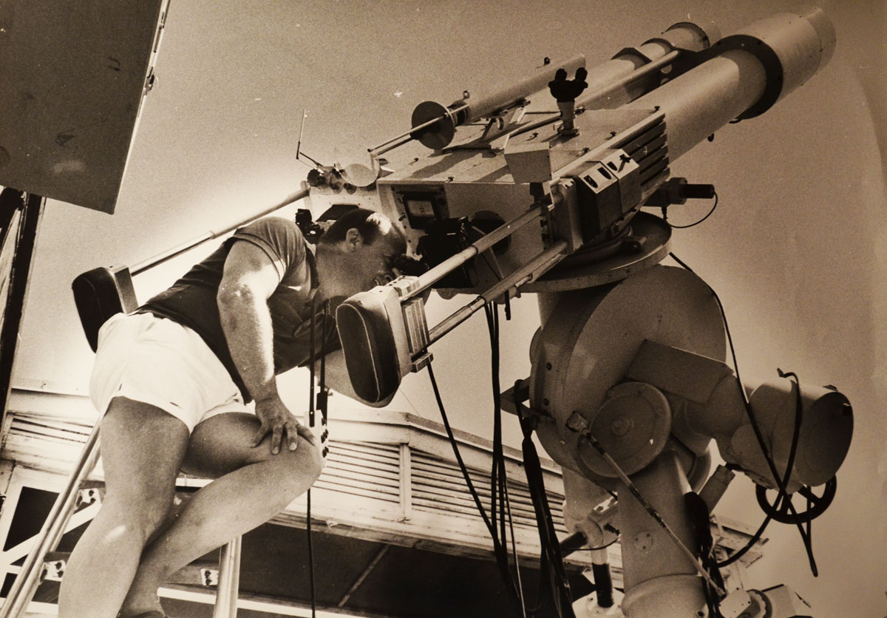
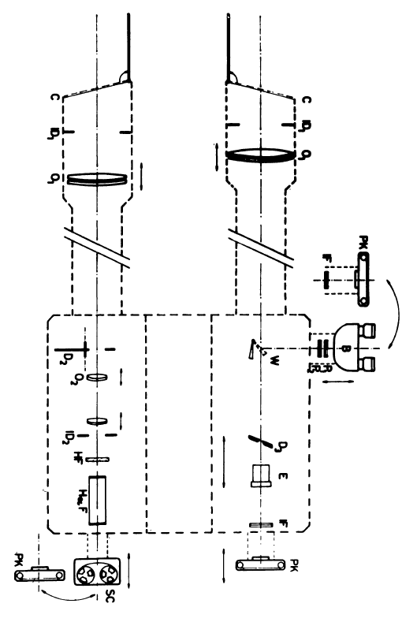
Photographic material aqusition system
1972 – 1997
Ambrož et al., 1977

Slide 4
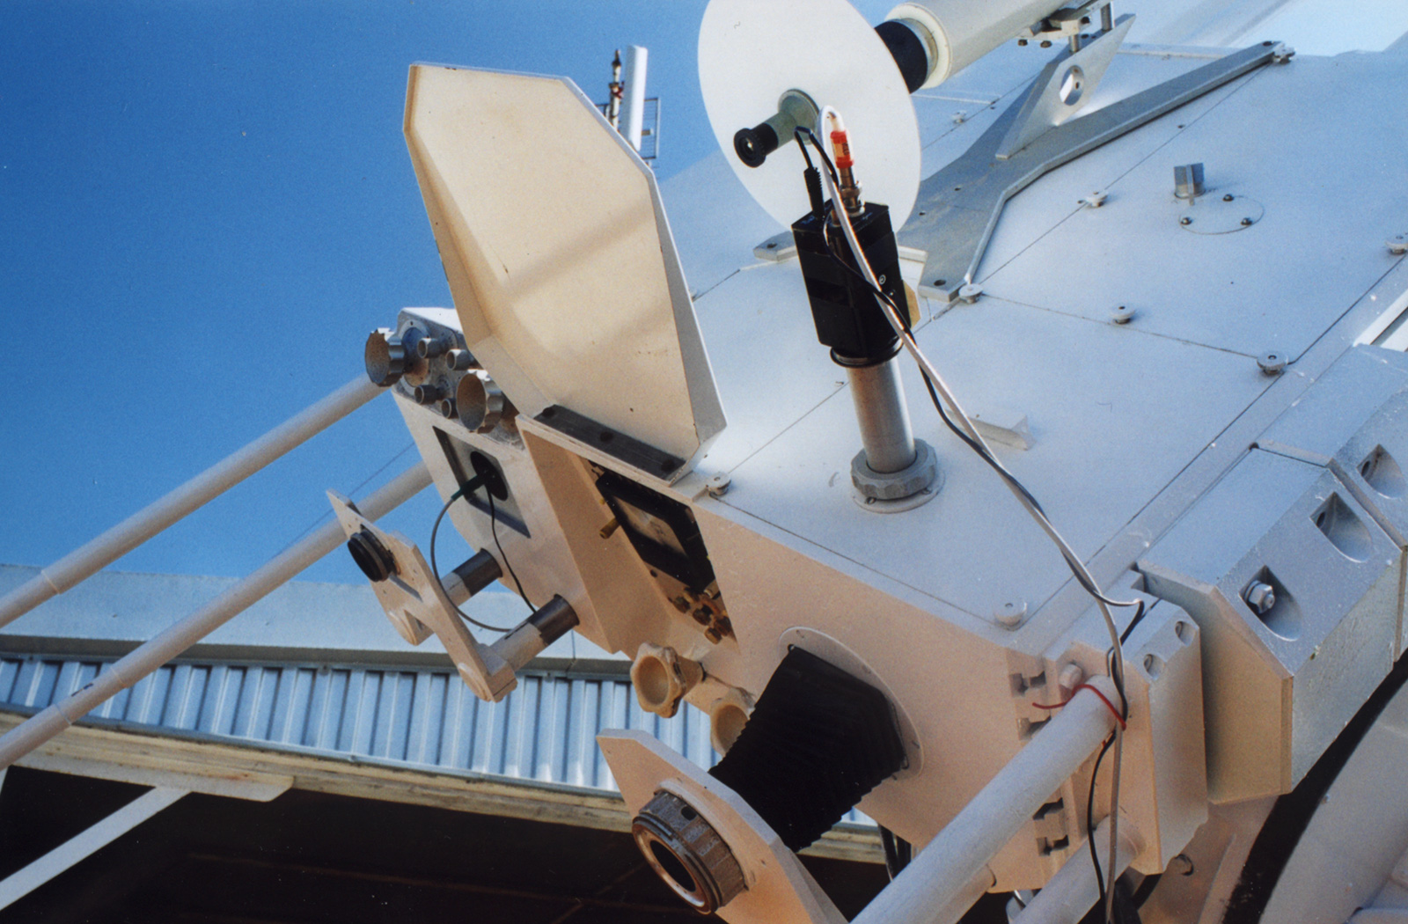
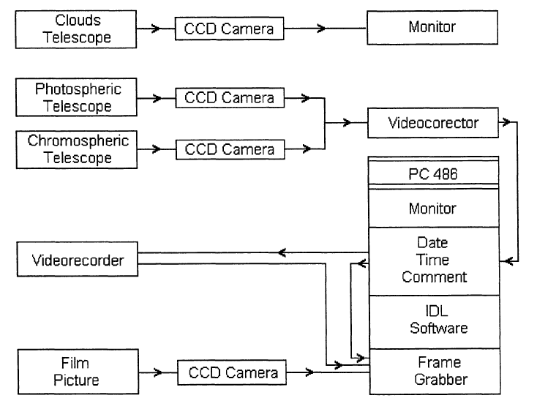
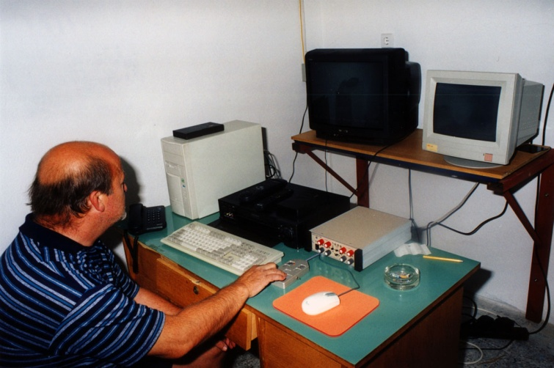
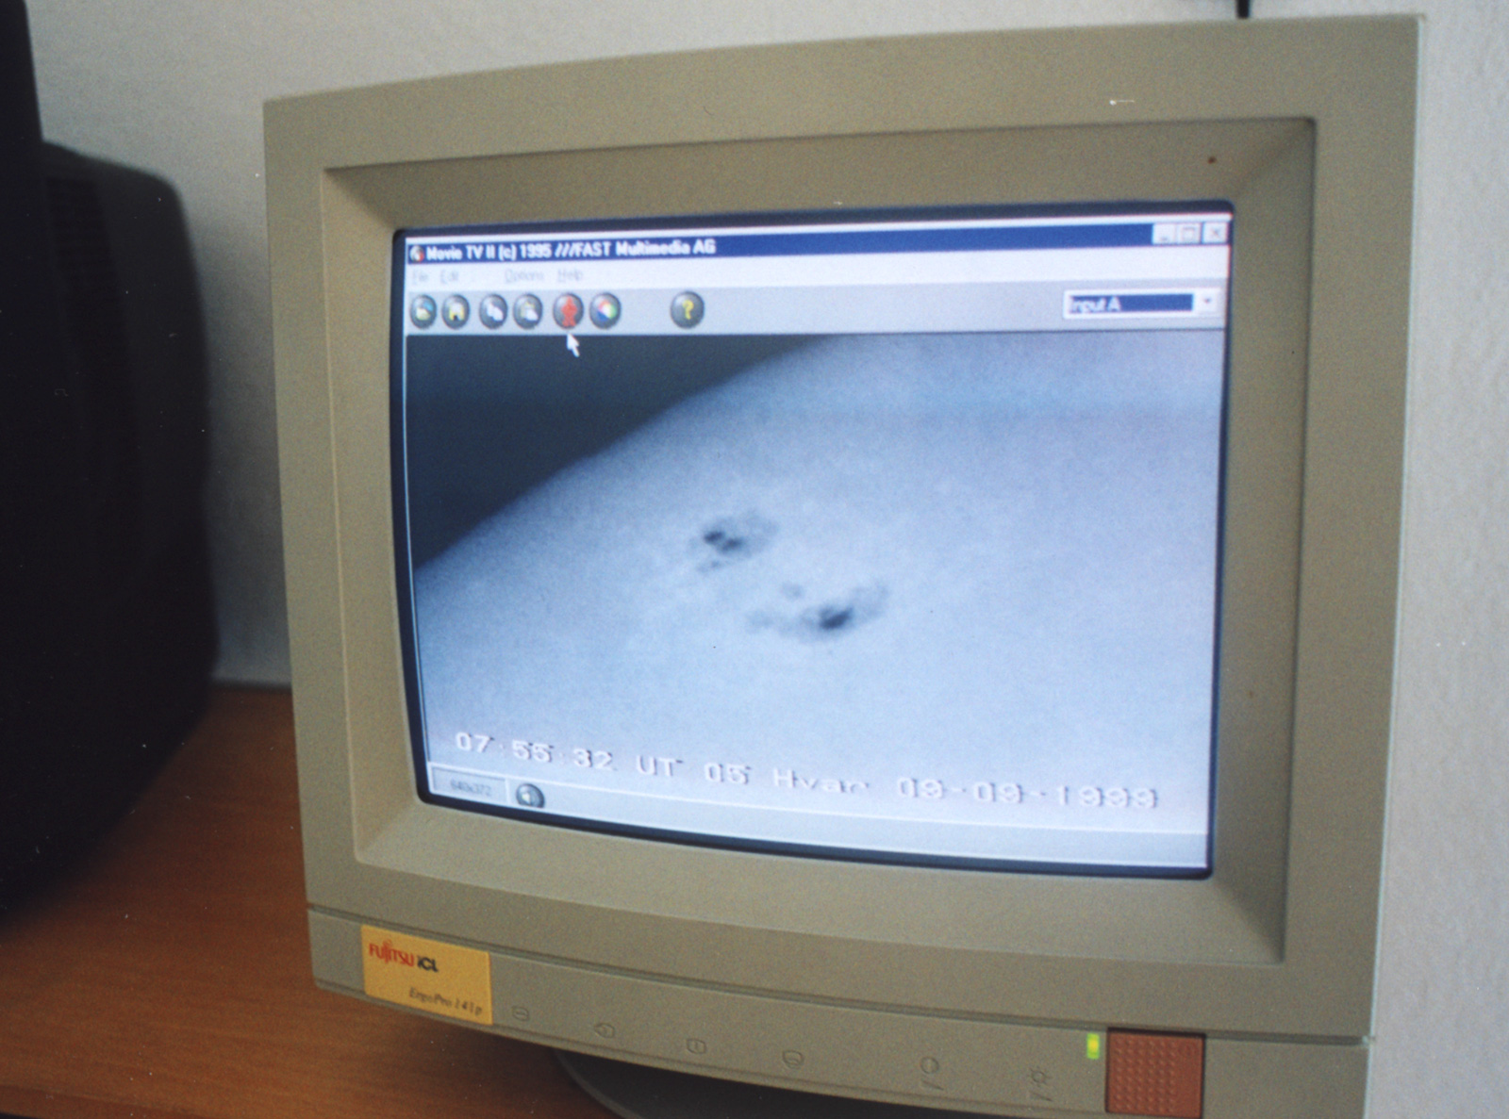
Video-recording acquisition system
1997 – 2004
Klvana and Bumba, 1997

Slide 5
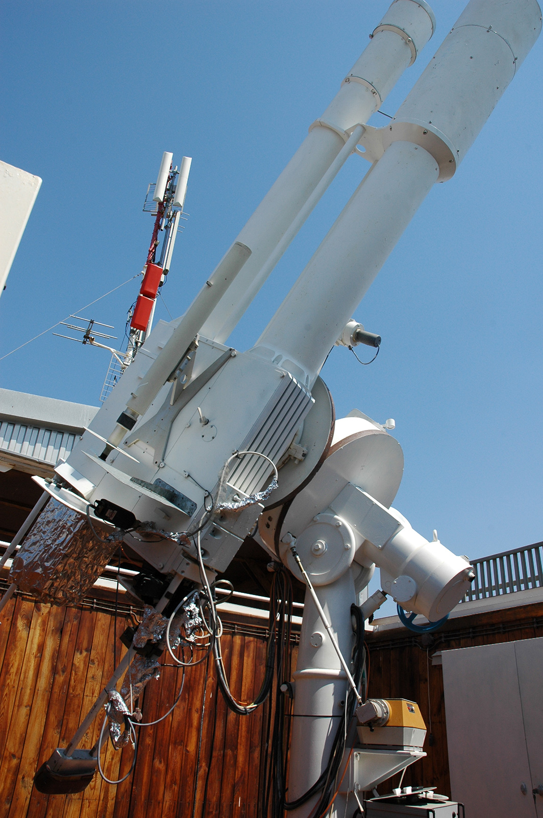
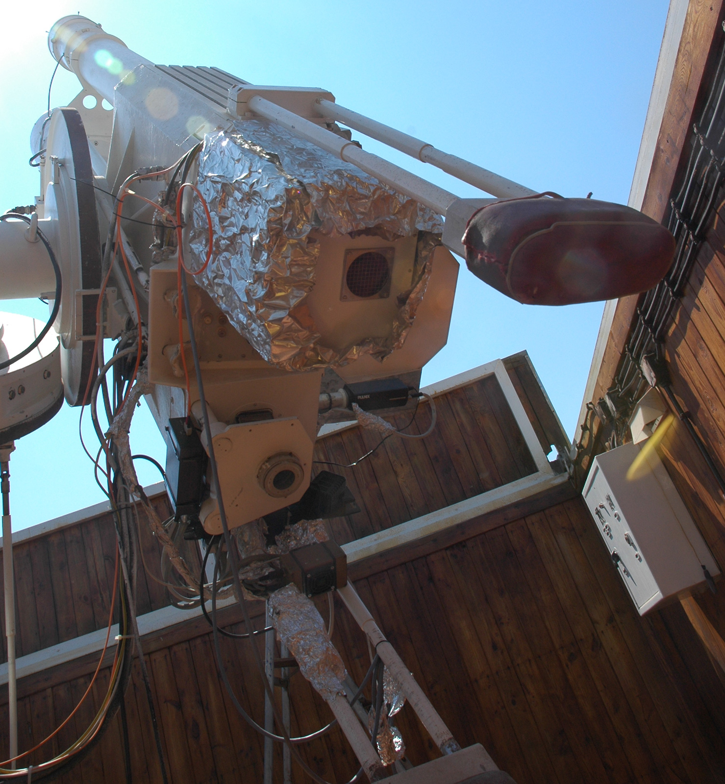
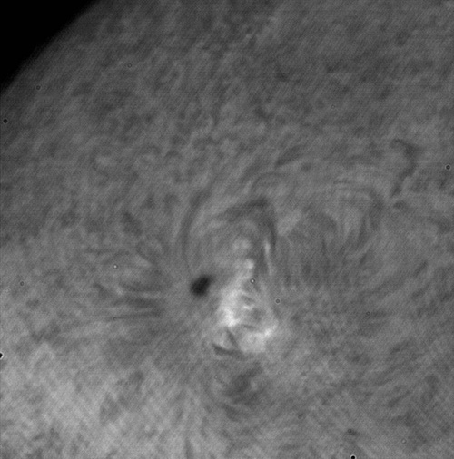
CCD camera aquisition system
2004 – 2010
1MPix 10-bit Pulnix TM-1010 CCD camera
Hα, 28.10.2009
Otruba, 2005

Slide 6
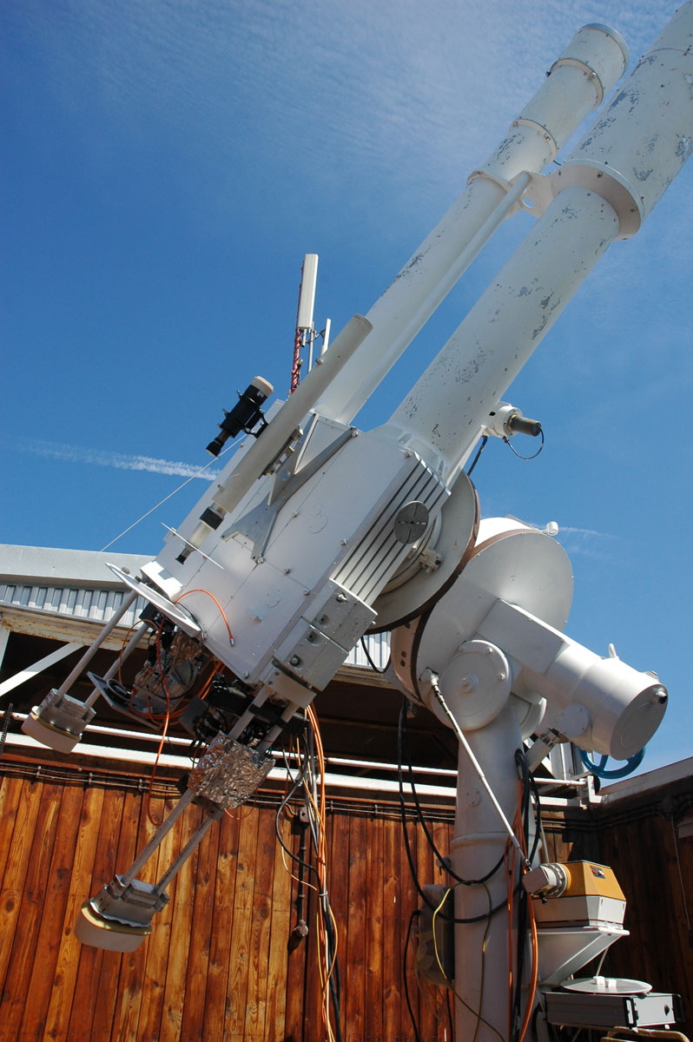
Double Solar Telescope at Hvar
2010 - today
fourth generation of acquisition hardvare and software
4MPix Pulnix TM-4200GE 12-bit CCD cameras
Identical acqusition system as the Kanzelhöhe Solar Observatory (collaboration with IGAM, Uni Graz)
Allows high-resolution images of active-regions on the Sun
Cadence up to 30 images per minute
New hardware is almost not affected by strong transmitter interferences
All data are stored to central archive on server in Zagreb (oh.geof.unizg.hr)

Slide 7
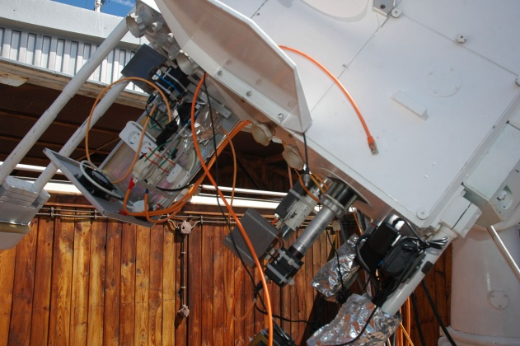
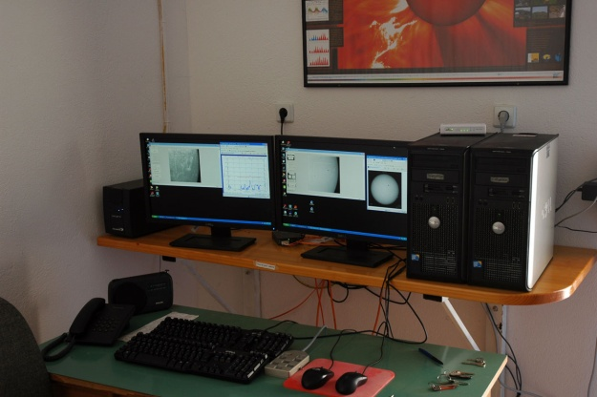
Some recent improvements
Photospheric telescope:
Baader AstroSolar film (ND 3.8) was introduced instead of prism (reduced telescope heating)
Simplified and improved optical design
Baader solar continuum and UV/IR filter were added
Mechanical tracking error significantly reduced by adjusting the telescope mount axes
New tracking motors
Electronic system for computerized tracking and control of the telescope (not yet fully operational)
Better internet connection (50Mbps)
New acquisition system - 2010
control room

Slide 8
Photospheric telescope
Main objective (acromatic doublet) with diameter of 217mm and focal lenght of 2450mm
Field of view: 11.3 arcmin
Resolution of 0.33 arcsec/pixel (2048x2048 CCD), oversampled images (1 arcsec for best seeing conditions)
Cadence: 1 image per minute

Slide 9
Cromospheric telescope
Main objective (acromatic doublet) with diameter of 130mm and focal lenght of 1950mm
Baader research grade filter (656nm) with passband 0.2Å
Field of view: 7.15 arcmin
Resolution of 0.21 arcsec/pixel (2048x2048 CCD), oversampled images
Cadence: 4 images per minute

Slide 10
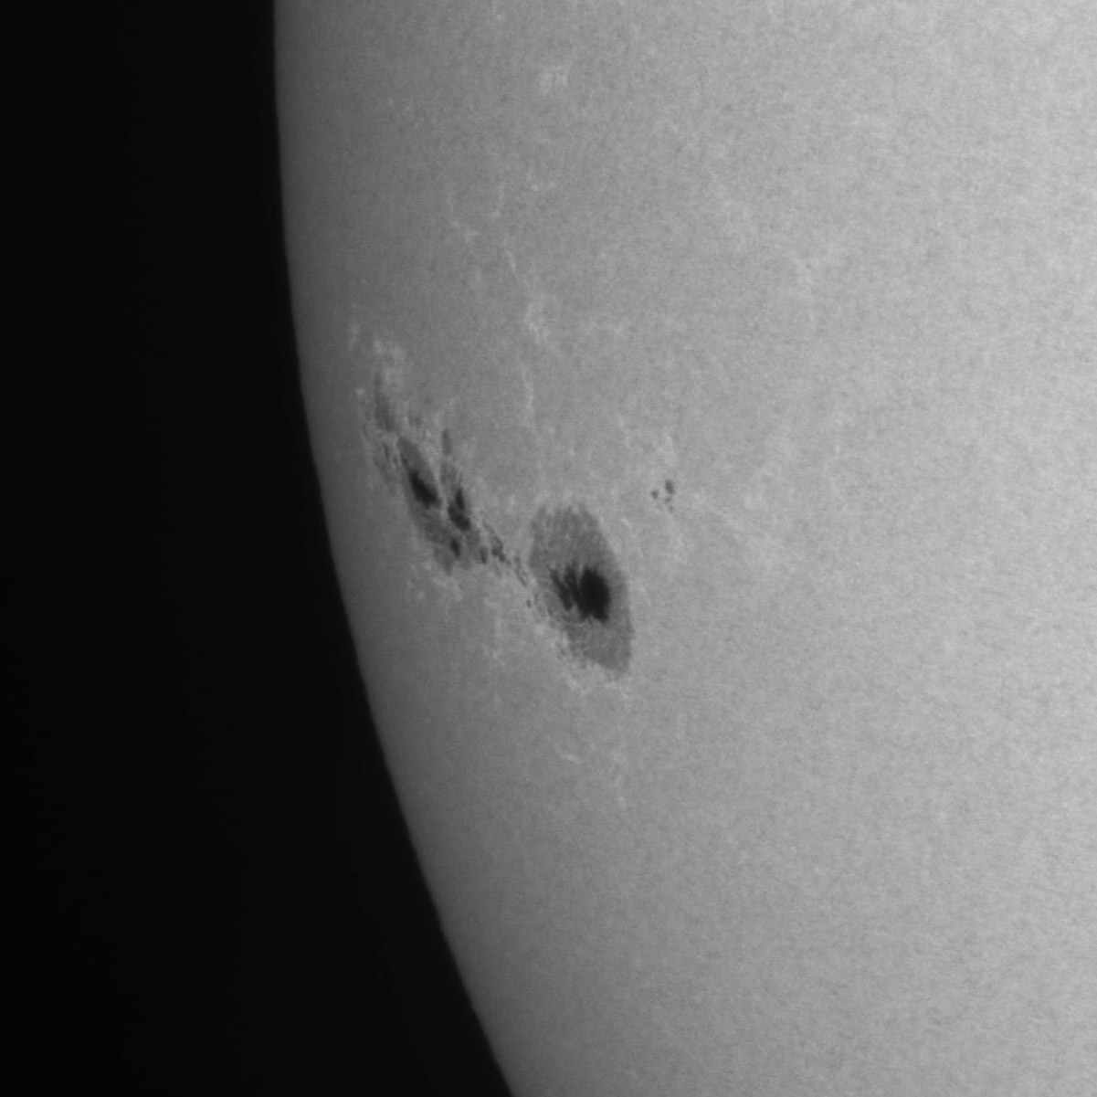
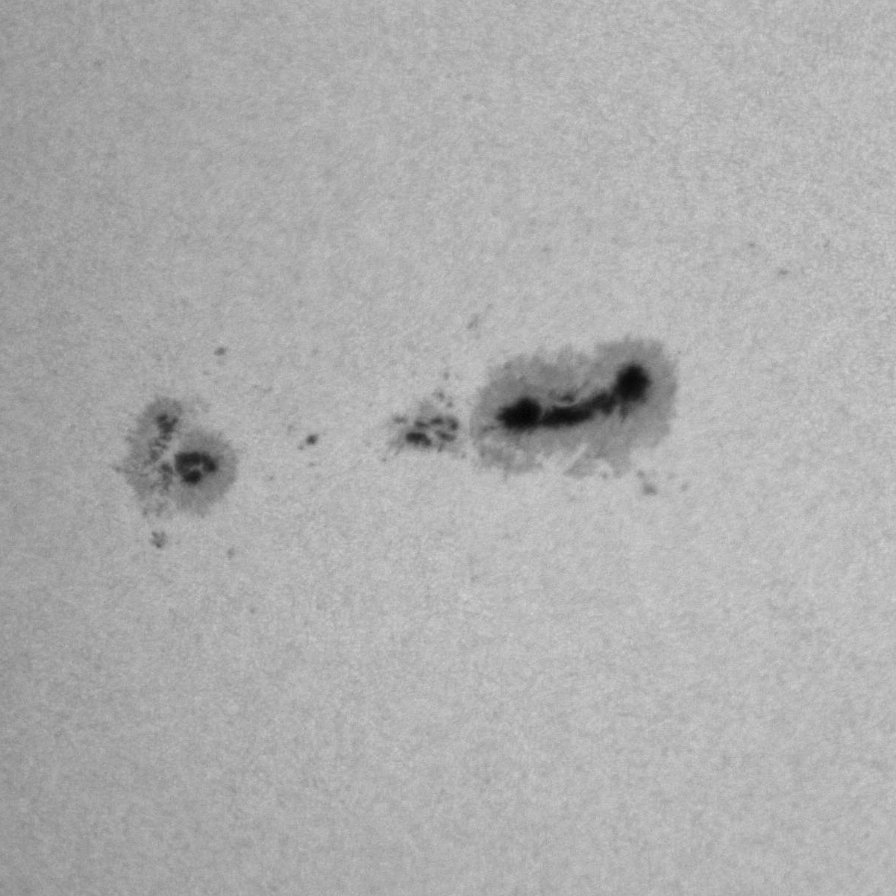
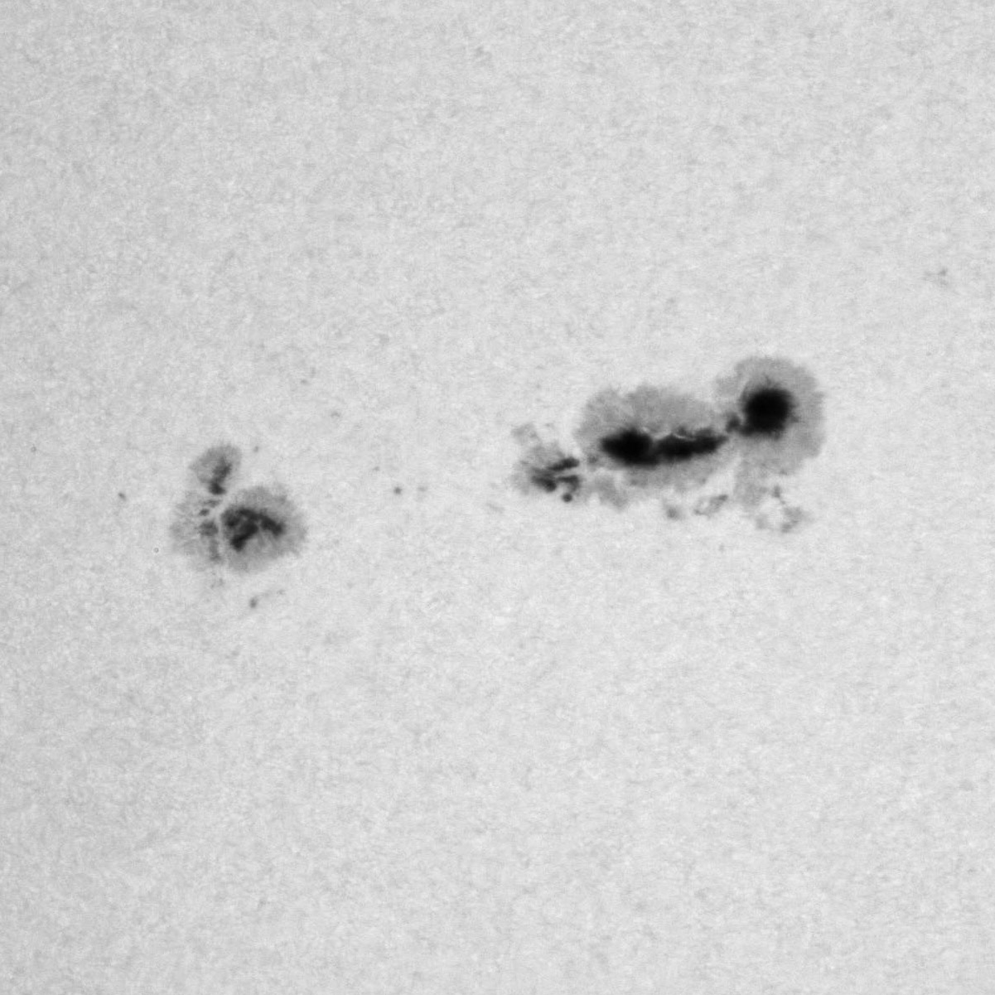
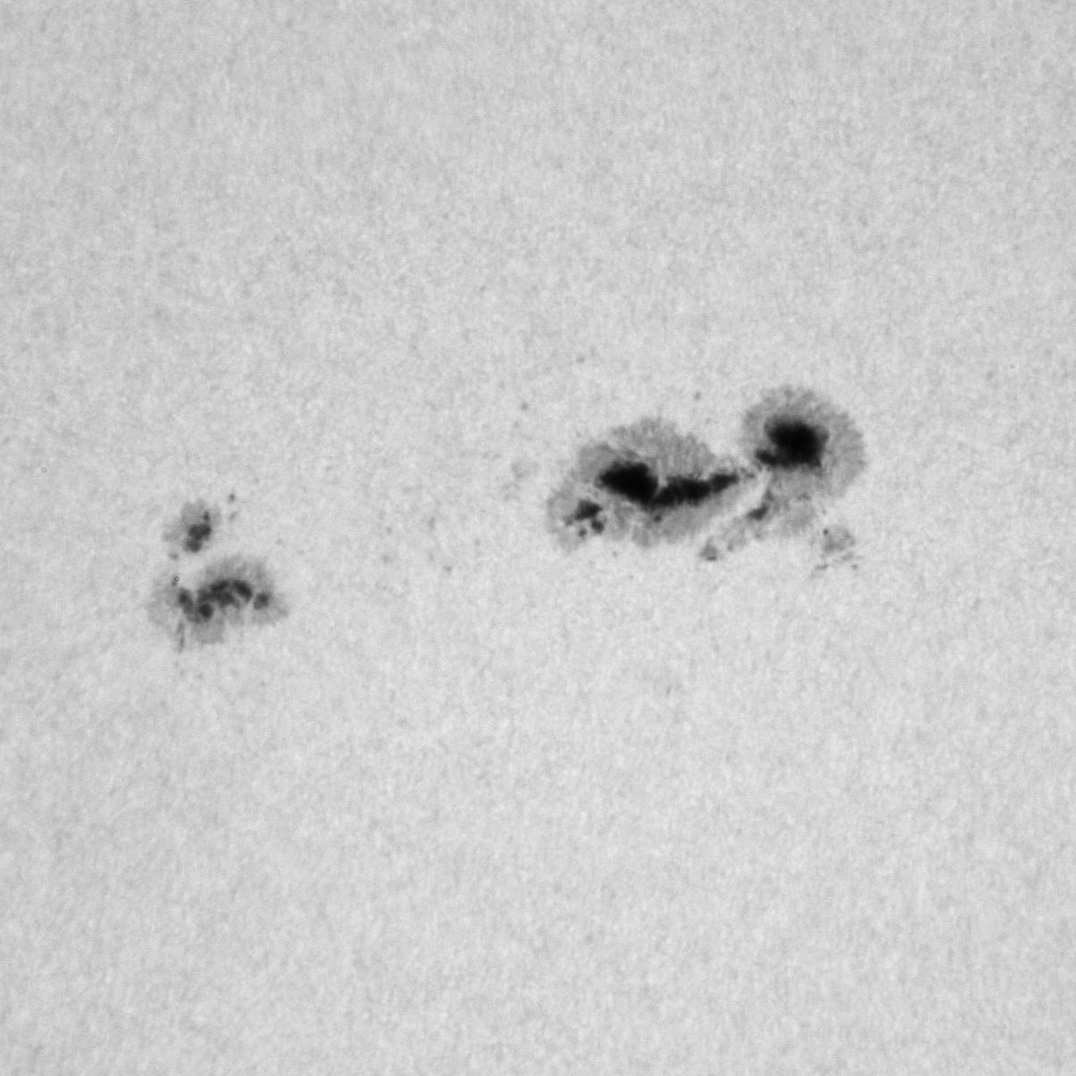
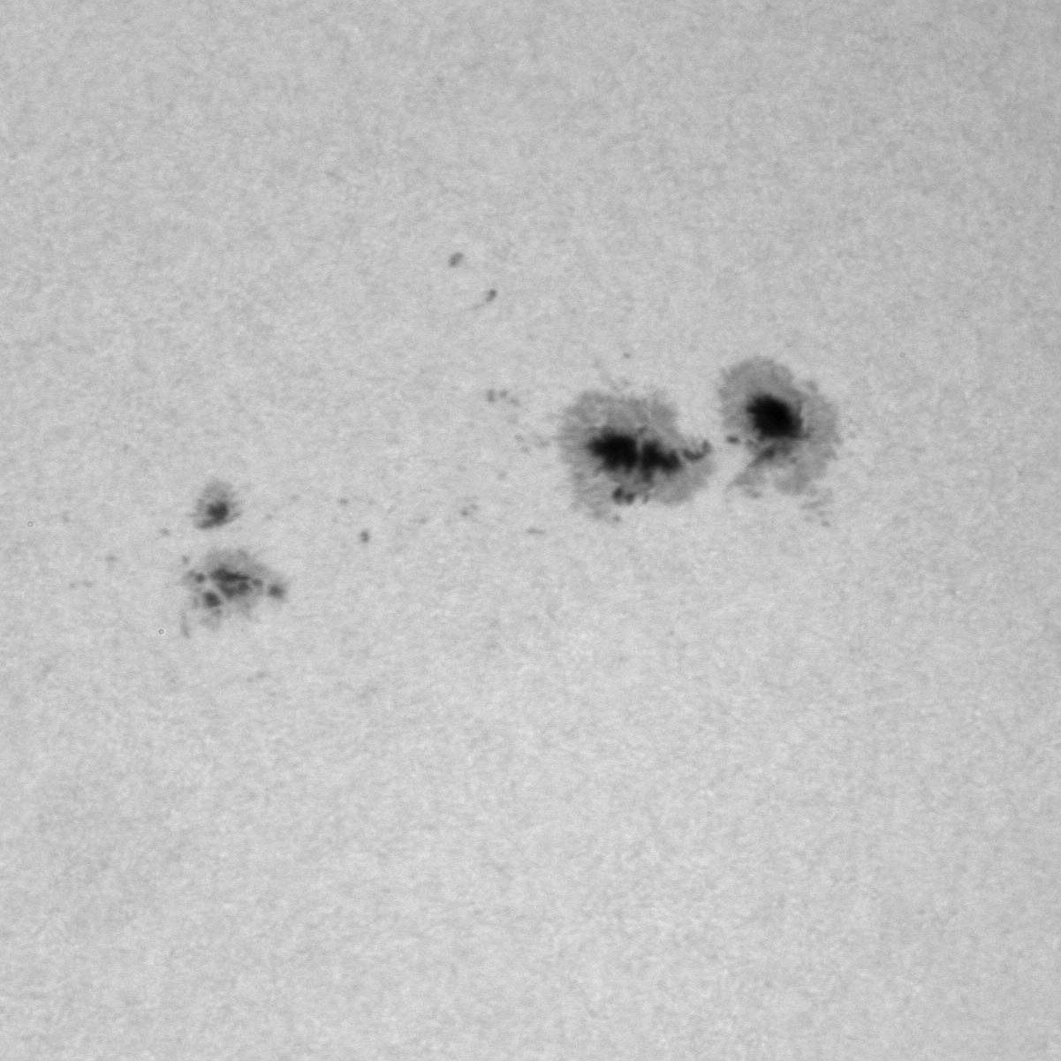
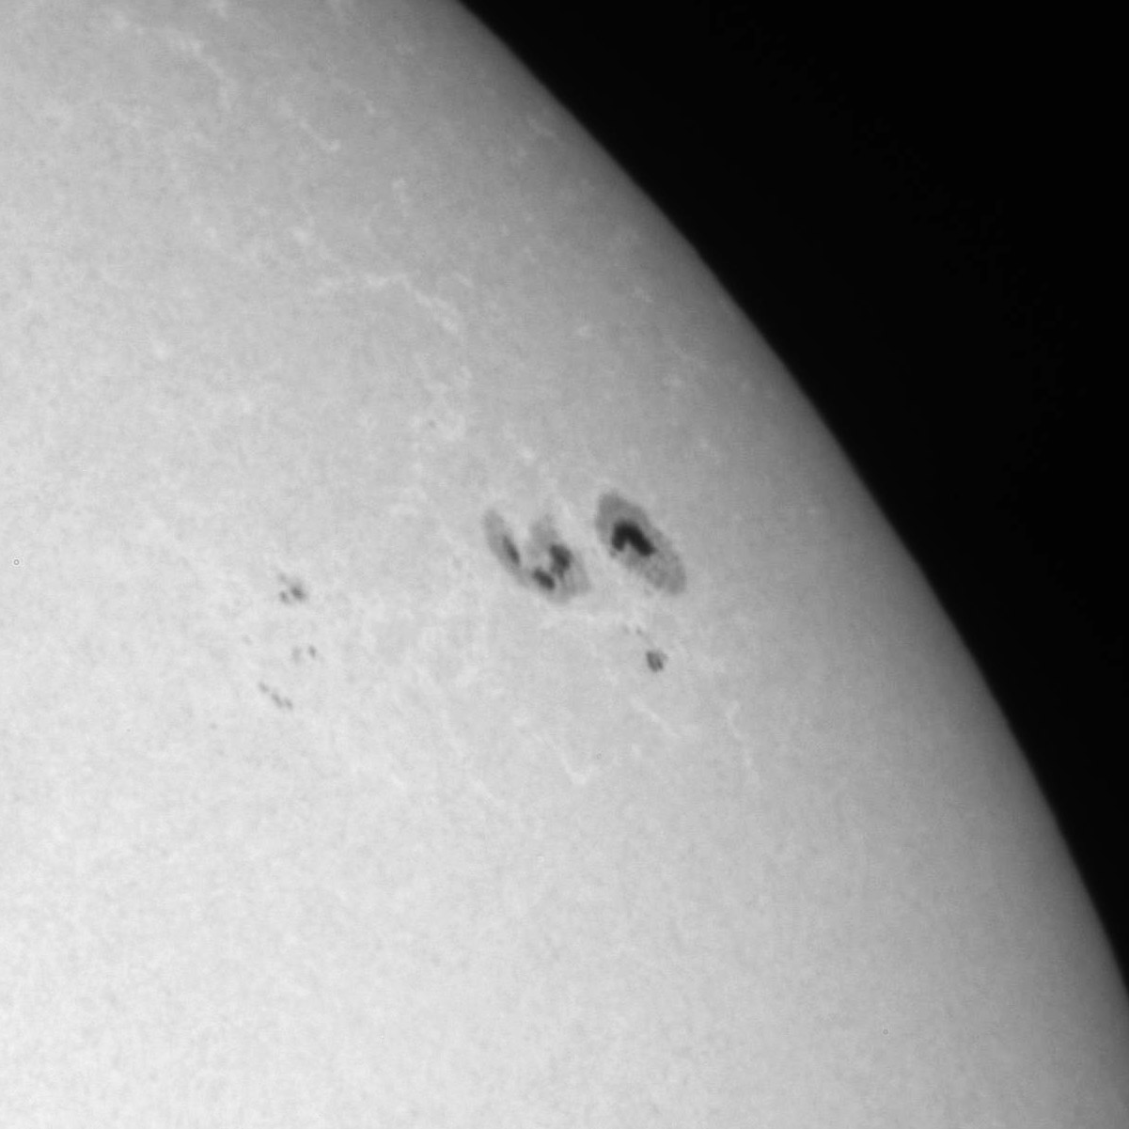
Observations in white light
Sunspot group: 11302
23.9.2011 08:52 UT
27.9.2011 11:40 UT
28.9.2011 08:03 UT
29.9.2011 06:44 UT
30.9.2011 10:19 UT
03.10.2011 07:39 UT
Notes:
8919 slika…

Slide 11
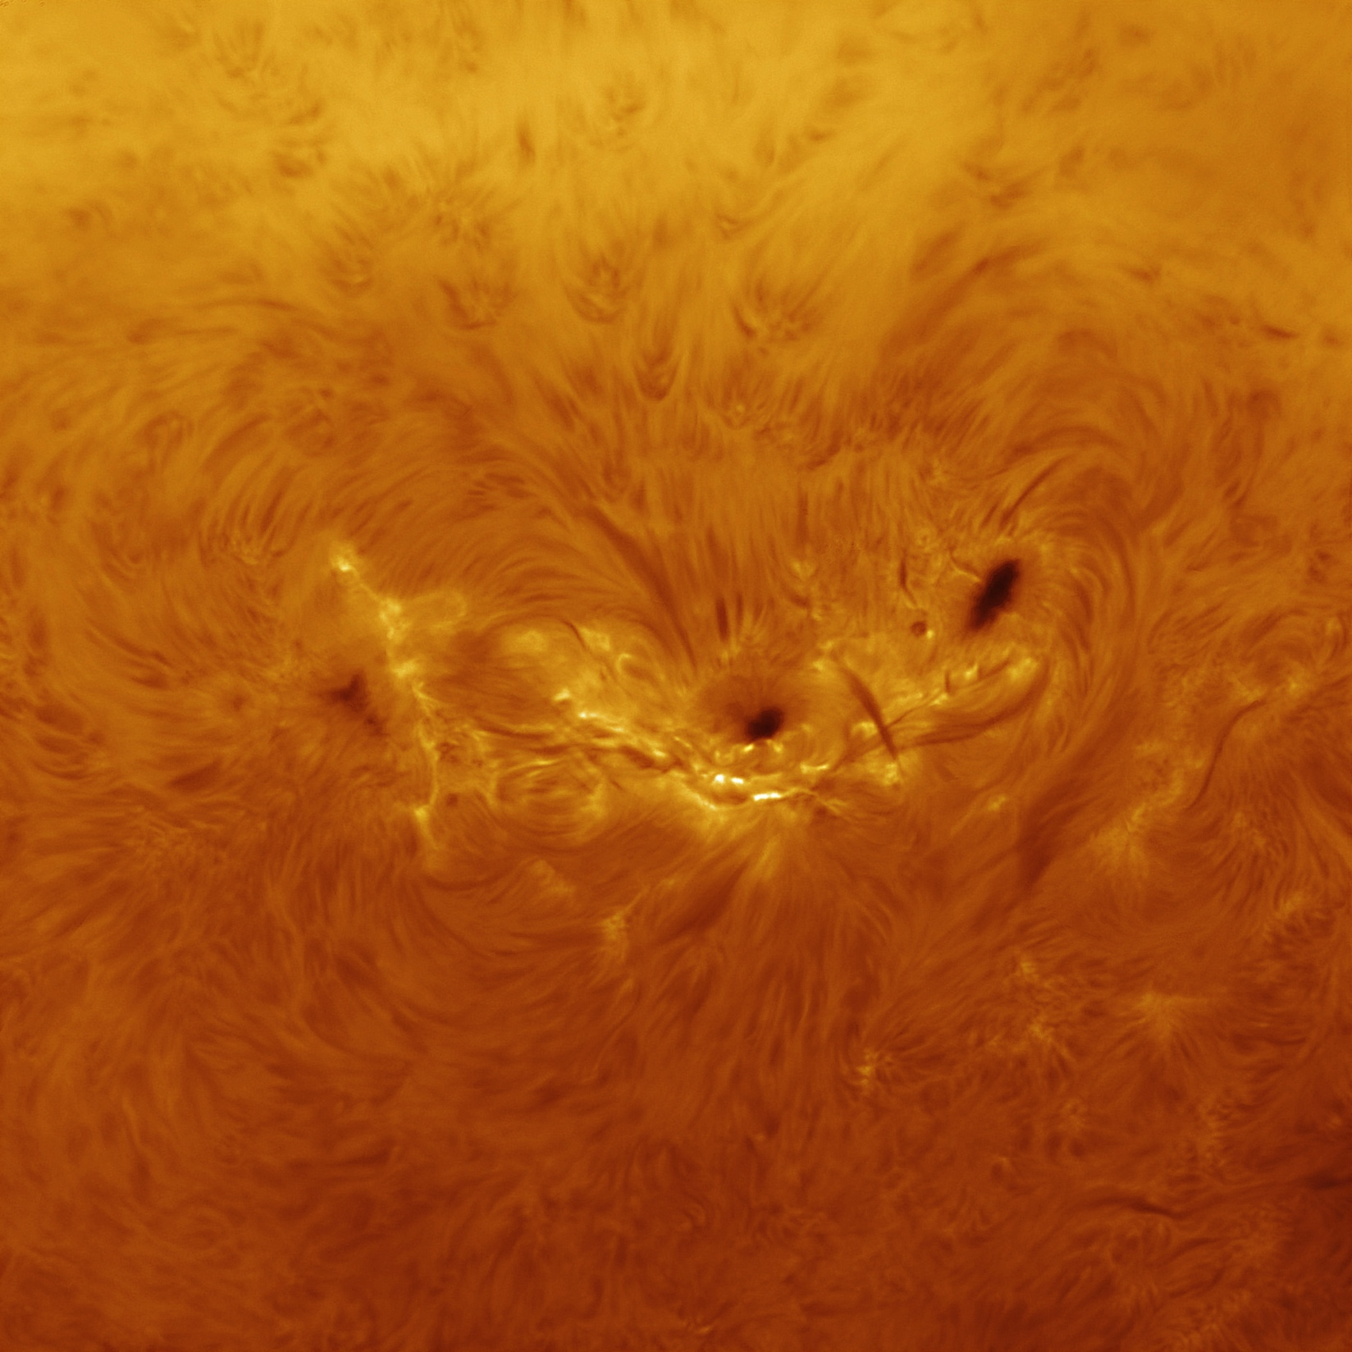
Observations in Hα
Processed image
04.07.2012, 11:55 UTC
Sunspot group: 1515

Slide 12
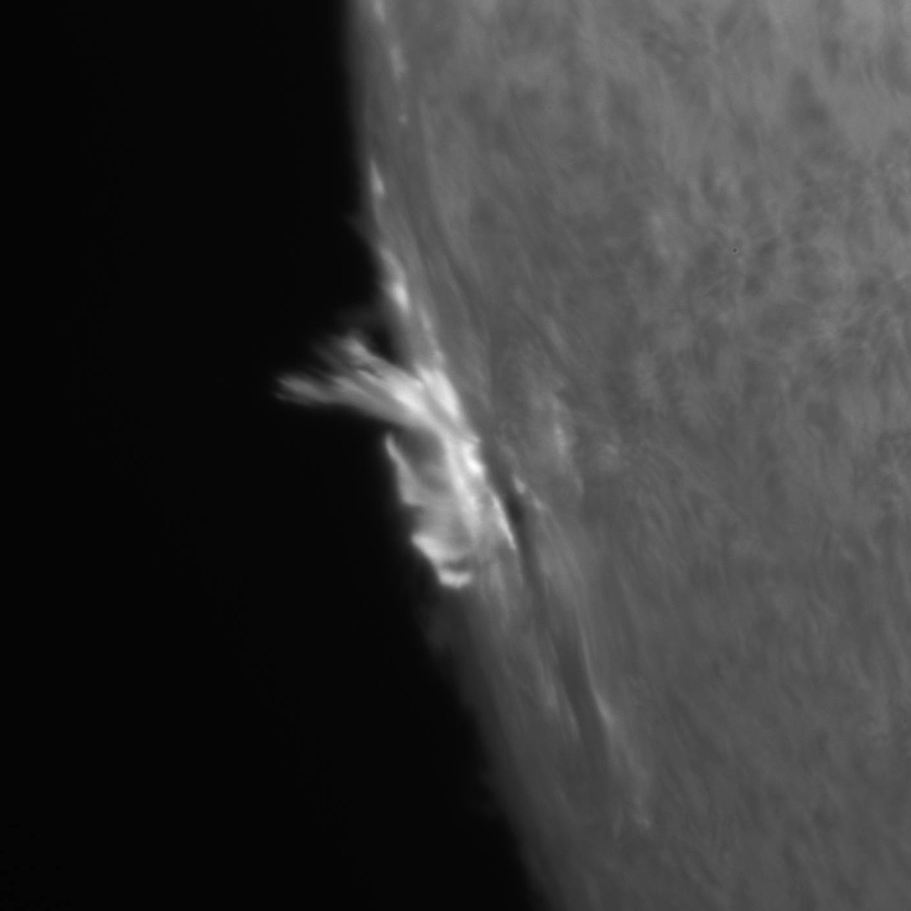
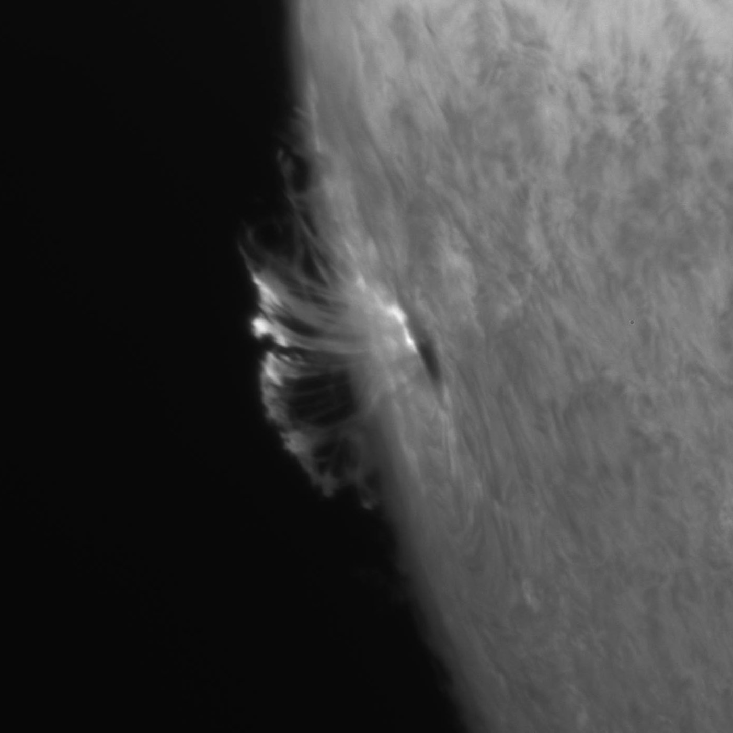
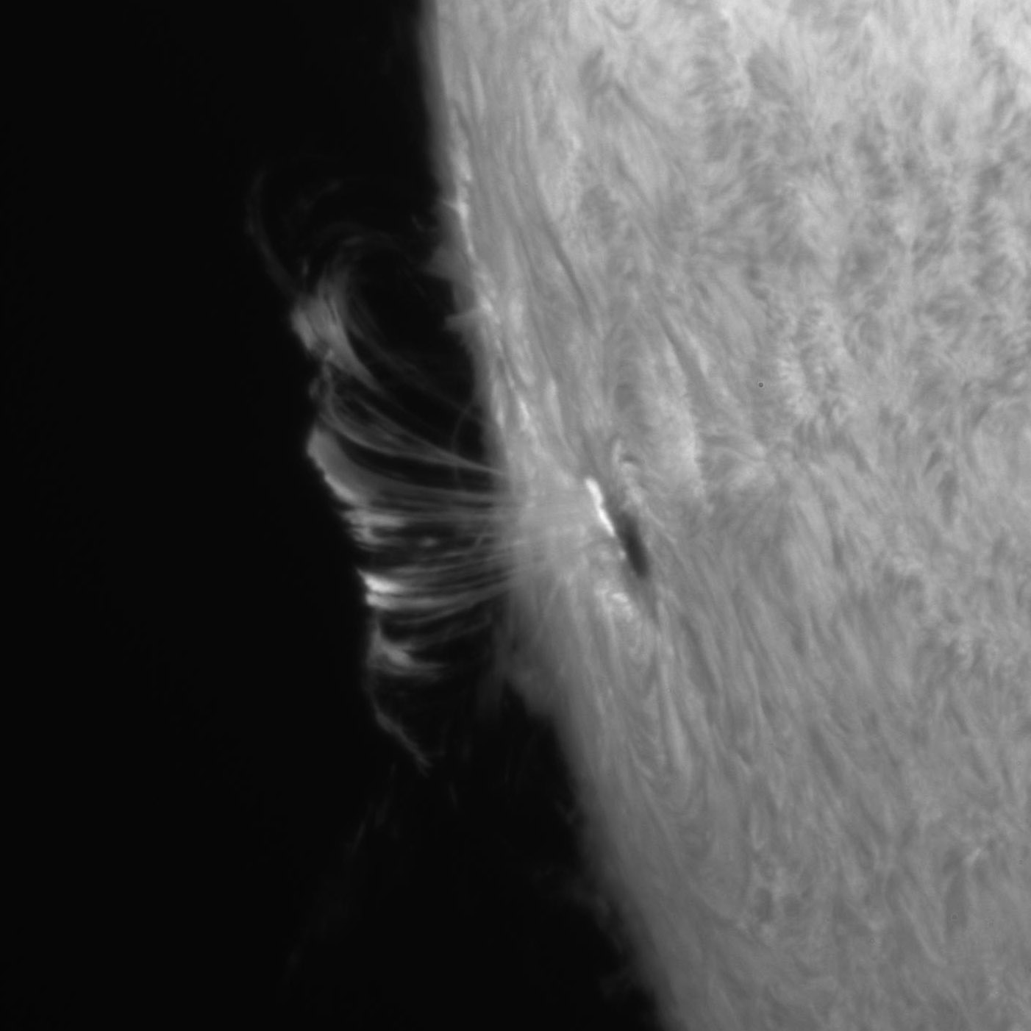
Observations in Hα
22. September 2011, sunspot group 11302, X1.4 flare
07:45:45 UT
07:57:32 UT
08:52:25 UT

Slide 13
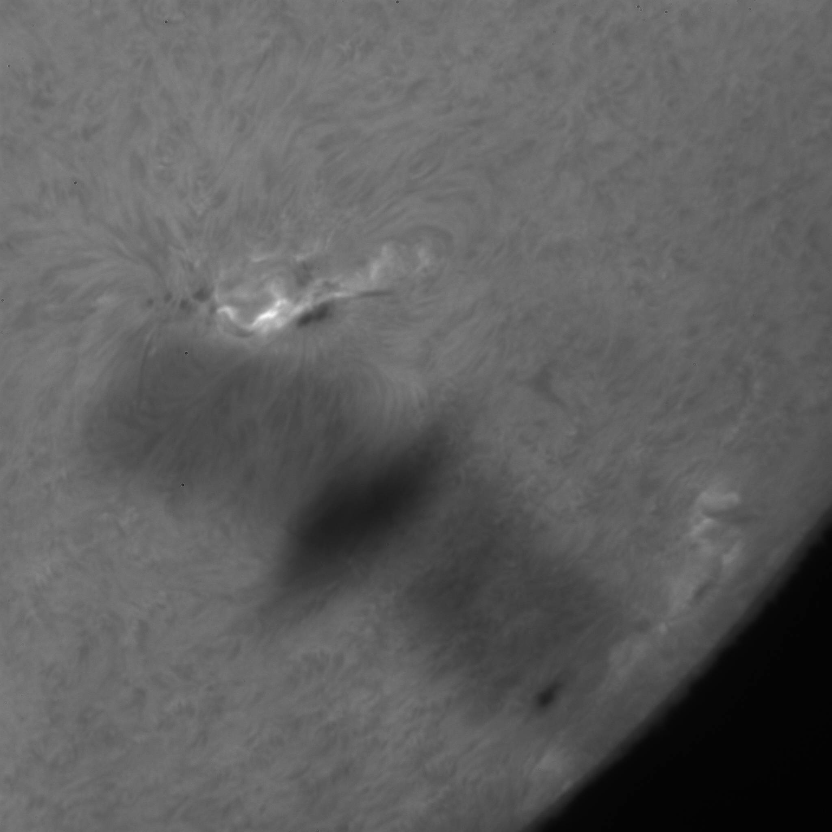
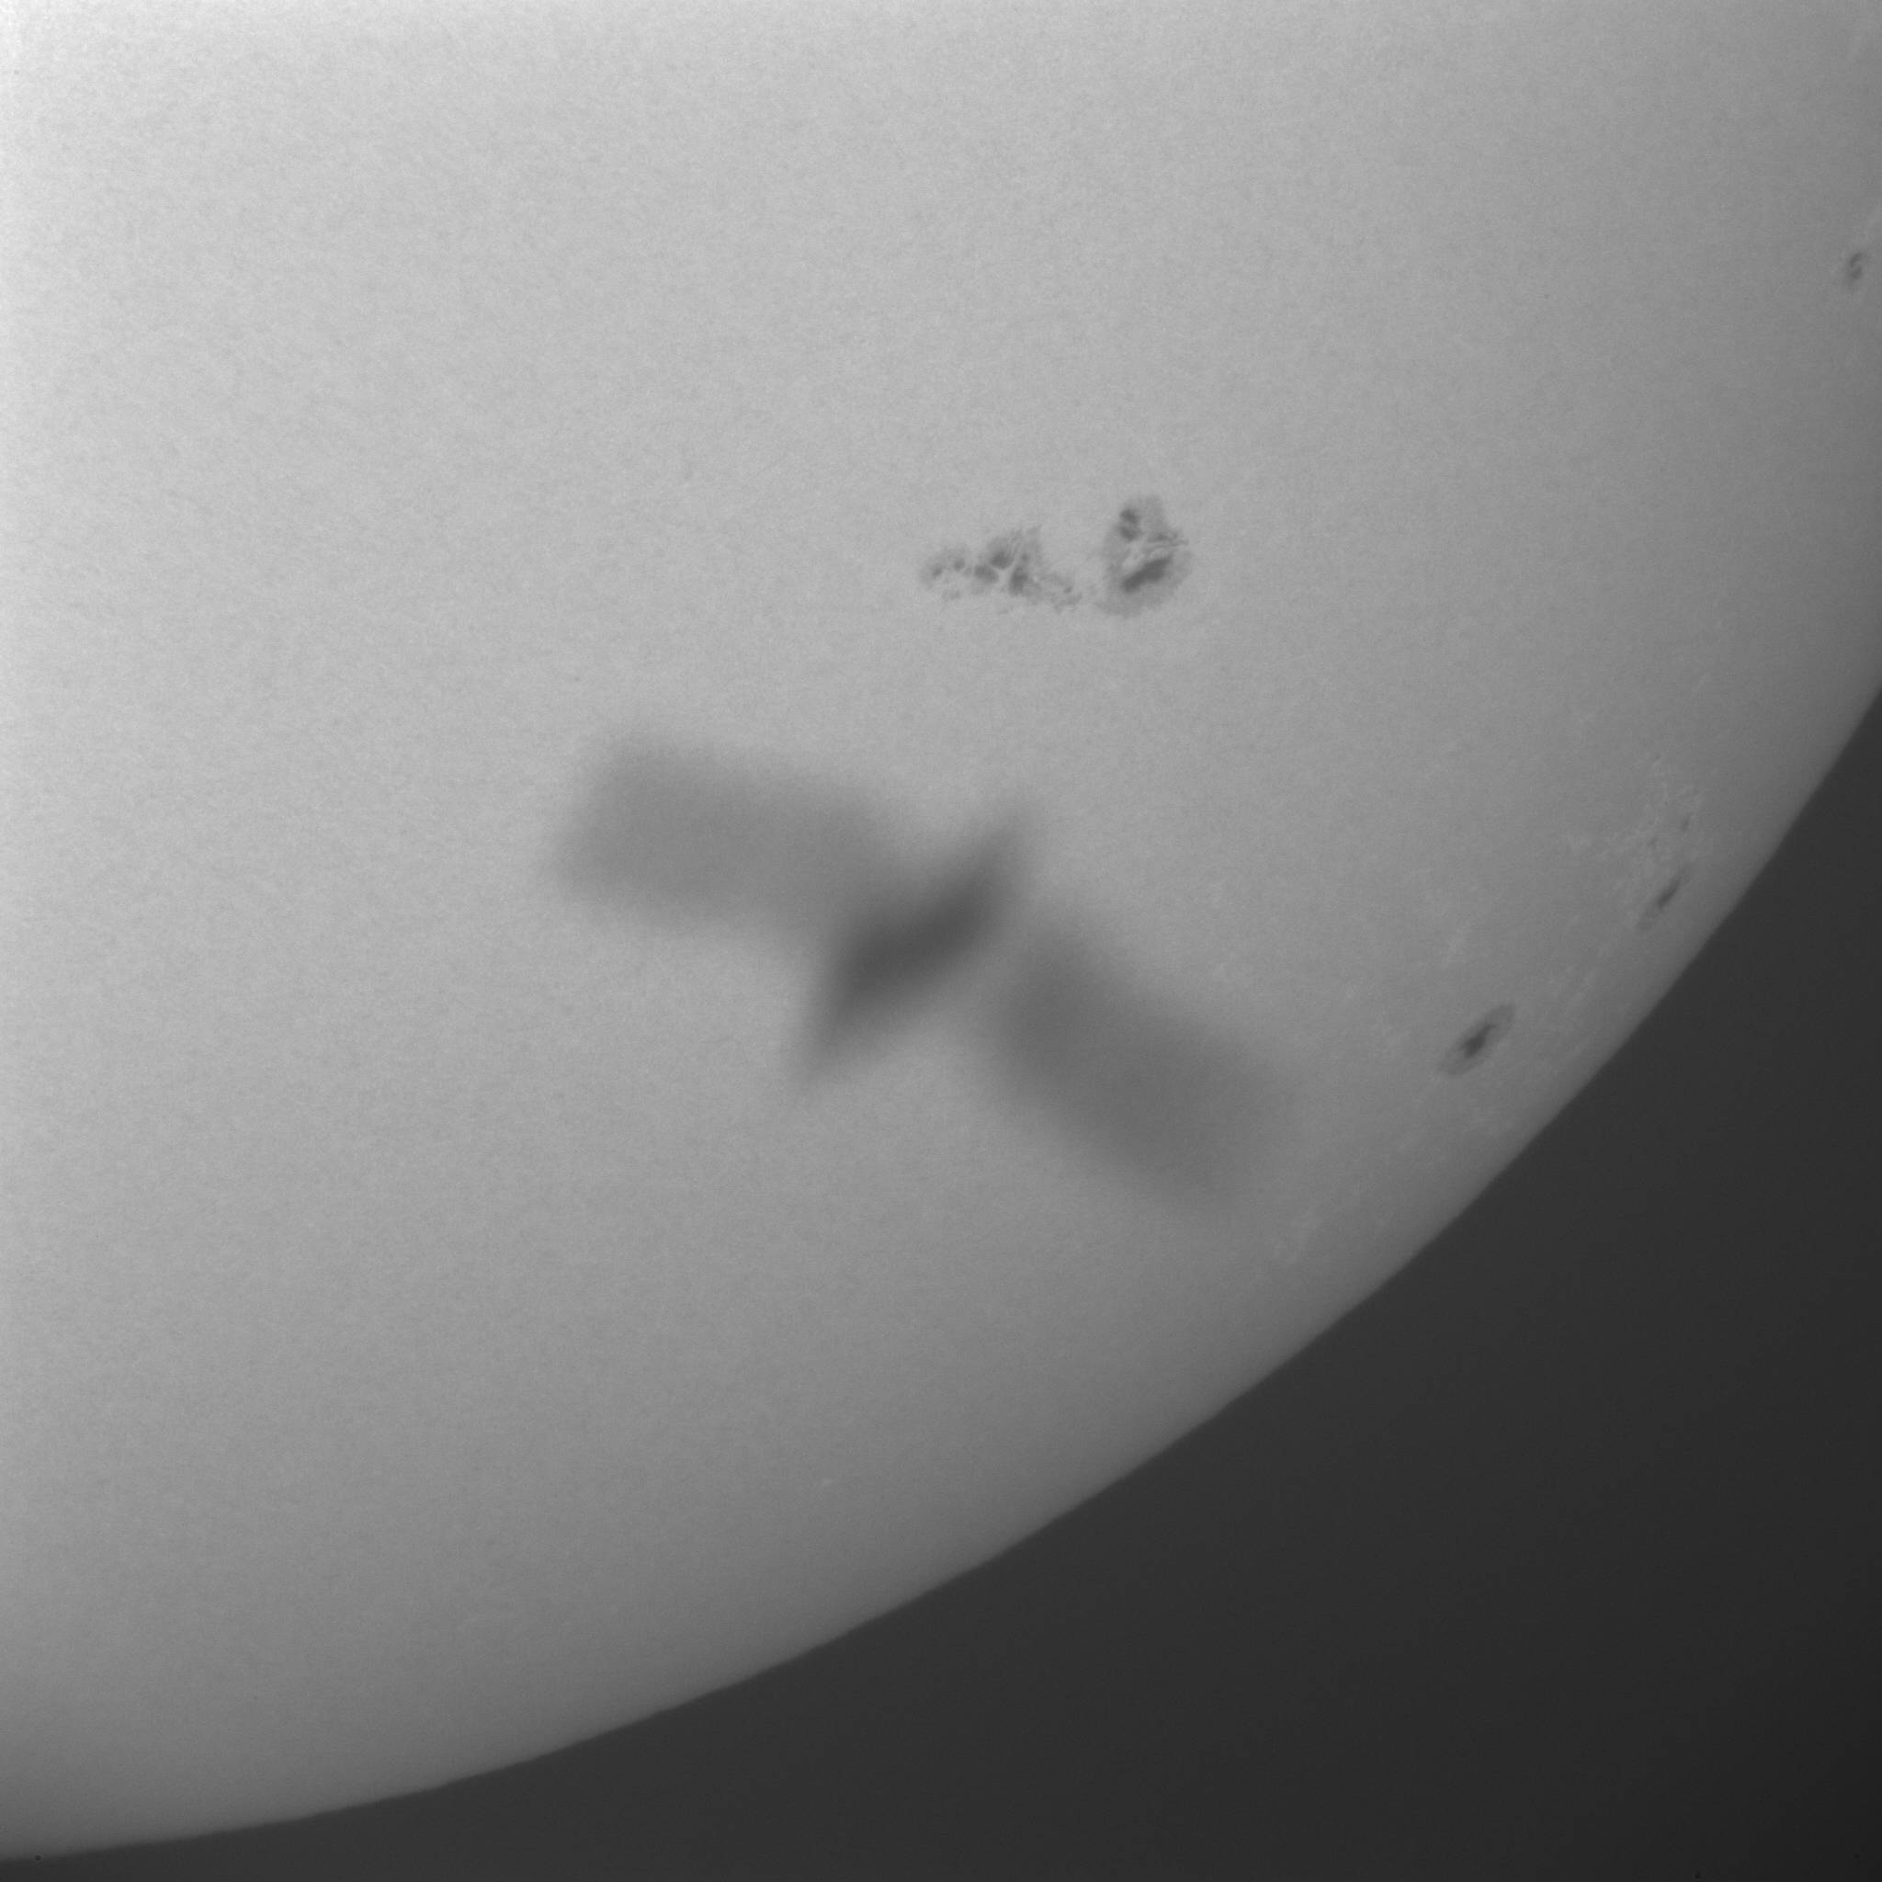
Some common artifacts at Hvar
27.10.2013, 12:02 UTC

Slide 14
Some stats about observations
6.5.2011 - 17.09.2014
Hα observations (cadence 15 sec):
Number of days observing: 321
Number of images: 320 500
Total duration: 1335h (55 days)
Size in archive: 2.6 Tb
WL observations (cadence 60 sec):
Number of days observing: 303
Number of images: 74 500
Total duration: 1241h (51 days)
Size in archive: 600 Gb

Slide 15
Distribution of observations 2011-2013

Slide 16
Some planned improvements on Hvar Solar Telescope
Fully computerized tracking system
Reconstruction of solar telescope dome
Improvment of data post-processing
Completion of web page interface to retrieve the data
Weather station (winter 2014/2015)

Slide 17
Thank you!
Data archive and more information about Hvar Solar Telescope:
http://oh.geof.unizg.hr/index.php/en/instruments/solar-telescope
Notes:
Zahvala Niksa Novak
Grad Hvar….
Katica Vucetic…

